Slide 1
Introduction to Codasip and RISC-V IP
BK Series Cores

Slide 2
The Company
Who We Are and What We Do

Slide 3
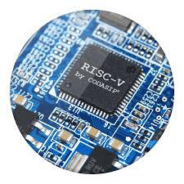
Who is Codasip?
The leading provider of RISC-V processor IP
Founded in 2014 in the Czech Republic
Based on 10 years of university research on processor design automation
Founding member of the RISC-V Foundation, www.riscv.org
Now Codasip GmbH, with offices in Silicon Valley and Czech Republic
Provides unique design automation tools for easy processor modification
IoT: performance/power efficiency and low-cost
Algorithm accelerators (DSP, security, audio, video, etc.)
Profiling of embedded SW for tailoring processor IP
Codasip Bk = portfolio of RISC-V processors
Codasip introduced its first RISC-V processor in November 2015

Slide 4
Codasip RISC-V Solutions
Reduce the cost of custom processor development
Automation and usage of standards enable custom processors to easily integrate into any design environment
Simplify custom processor programming
Generate open-source tools for any processor type to deliver powerful technology that is easy to integrate
Enable extensible and fully custom processor methodologies
Make small optimizations to proven processor IP, or implement a completely unique processor solution

Slide 5
BK: Customizable RISC-V Cores
Codasip RISC-V cores are all pre-verified, tape-out quality IP
Codasip RISC-V cores are all customizable
RISC-V ISA extensions for your application needs
Easily create new processor resources
Custom registers for computations
Custom control-status registers
Custom interfaces such as GPIO, FIFO, scratch-pad memory
Even modify the pipeline…

Slide 6
BK cores Roadmap
Comprehensive offering including new advanced designs
Bk3, Bk5, Bk5-64, Bk7
Available now, 100% RISC-V compliant
Fully customizable
Address wide performance range
Bk future cores
High-performance cores
Advanced pipelines
Comprehensive DSP features
Most energy-efficient cores
Bk future
Bk7
Bk5
Bk5-64
Performance
Bk3
Bk future
Complexity
Notes:
Do in man-days what would otherwise take many man-years

Slide 7
Customization & Tools
Our Solutions for Easy RISC-V Customization

Slide 8
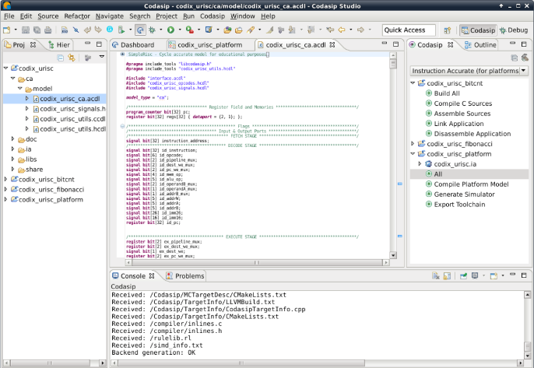
Codasip Studio
Studio = unique collection of tools for fast & easy modification of RISC-V processors. All-in-one, highly automated. Introduced in 2014, silicon-proven by major vendors.
Customization of base instruction set:
Single cycle MAC
Custom crypto functions
And many more…
Complete IP package on output:
C/C++ LLVM-based compiler
C/C++ Libraries
Assembler, disassembler, linker
ISS (incl. cycle accurate), debugger, profiler
UVM SystemVerilog testbench
Codasip Studio
CodAL – processor description language
element i_mac { use reg as dst, src1, src2; assembly { “mac” dst “,” src1 “,” src2 }; binary { OP_MAC dst src1 src2 0:bit[9] }; semantics { rf[dst] += rf[src1] * rf[src2]; }; };
RTL Automation
Verilog
VHDL
SDK automation
Integrated processor development environment
Verification Automation

Slide 9
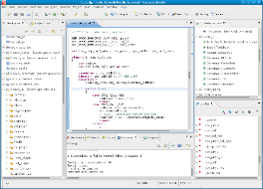
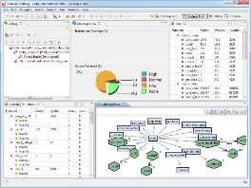
Bk Core Customization with Codasip Studio
Start from Bk3/5/7 cores
Add instructions
Add resources
Modify pipeline
…
Your RISC-V CodAL Models
Profiling of embedded application SW enables processor optimizations
Codasip Studio Toolset
Your RISC-V
HDK
Your RISC-V
SDK
Hardware Design Kit
RTL models
Synthesis scripts
Verification models and simulators
Virtual prototypes
Software Design Kit
Compiler
Assembler
Linker
Debugger
IDE etc
ISA extensions are quickly implemented and analyzed during design space exploration
Codasip Studio automatically generates all processor IP design kits and verifies for RISC-V compliance (you still need to verify your own resources and instructions).

Slide 10
Configuration and Custom Extensions
RISC-V offers a wide range of ISA modules:
I/E for integer instructions
M for multiplication and division
C for compact instruction
F/D for floating point operations
WIP: B, P, V, …
However, it may not be enough for your application domain or if you are looking for a key differentiator…
RISC-V allows custom extensions
SDK must be aware of the custom extensions
High level of automation needed
Codasip has tools for this task: Codasip Studio

Slide 11
ISA Customization Benefits
ISA customization achieves PPA optimization
Performance: Efficient ISA will reduce the number of instructions for tasks.
Power: Efficient ISA will reduce total cycle counts thus reducing MHz.
Area: Efficient ISA can reduce code size and data size (table) so that total area (logic and memory) becomes smaller, too.
ISA customization can be your differentiator…
…while keeping vast majority of ecosystem benefits.

Slide 12
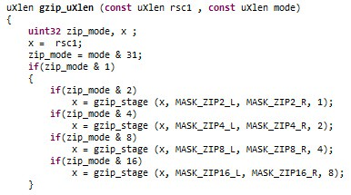
Example: B Extension Functional Model
Written in CodAL
In 10 days by a single engineer
900 LOC
SDK with C compiler, ISS and profiler to check the impact of the extensions is automatically generated by Studio
Compiler can use a subset of instructions automatically (rotations, compact instructions, shifts, etc.)

Slide 13
Example: B Extension Implementation Model
Written in CodAL
In 3 weeks by a single engineer
1500 LOC
Hardware design kit (HDK) with RTL, testbench and UVM based verification environment automatically generated by Studio

Slide 14
Why Customization-Aware SDK?
One of the biggest advantages of the RISC-V open ISA is customization. However, a customized processor also needs a customized SDK…
Standard customization (manually adding custom ISA extensions):
Model and simulate a new instruction
Modify the compiler
Modify assembler
Add support in the debugger
Verify, verify, verify…
→ Challenging, time-consuming, expensive
Benefits of automatic generation of a customized LLVM compiler:
Reduced time needed for compiler modification
Reduced cost of custom processor development
The resultant processor will be easily programmable using standard C/C++
Proven open-source LLVM framework allows for easy integration

Slide 15
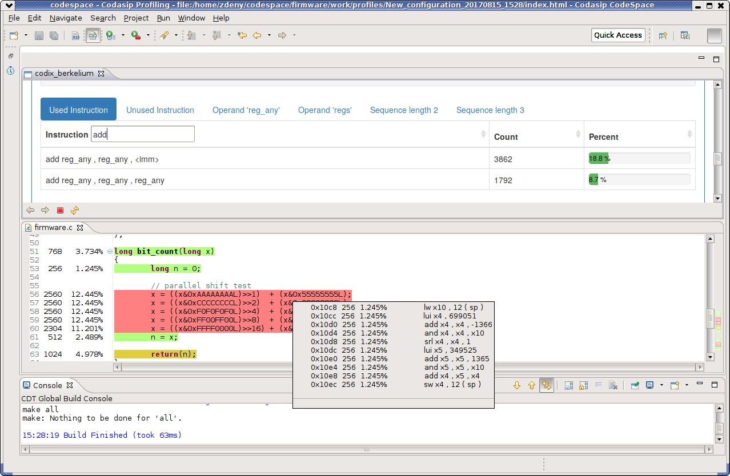
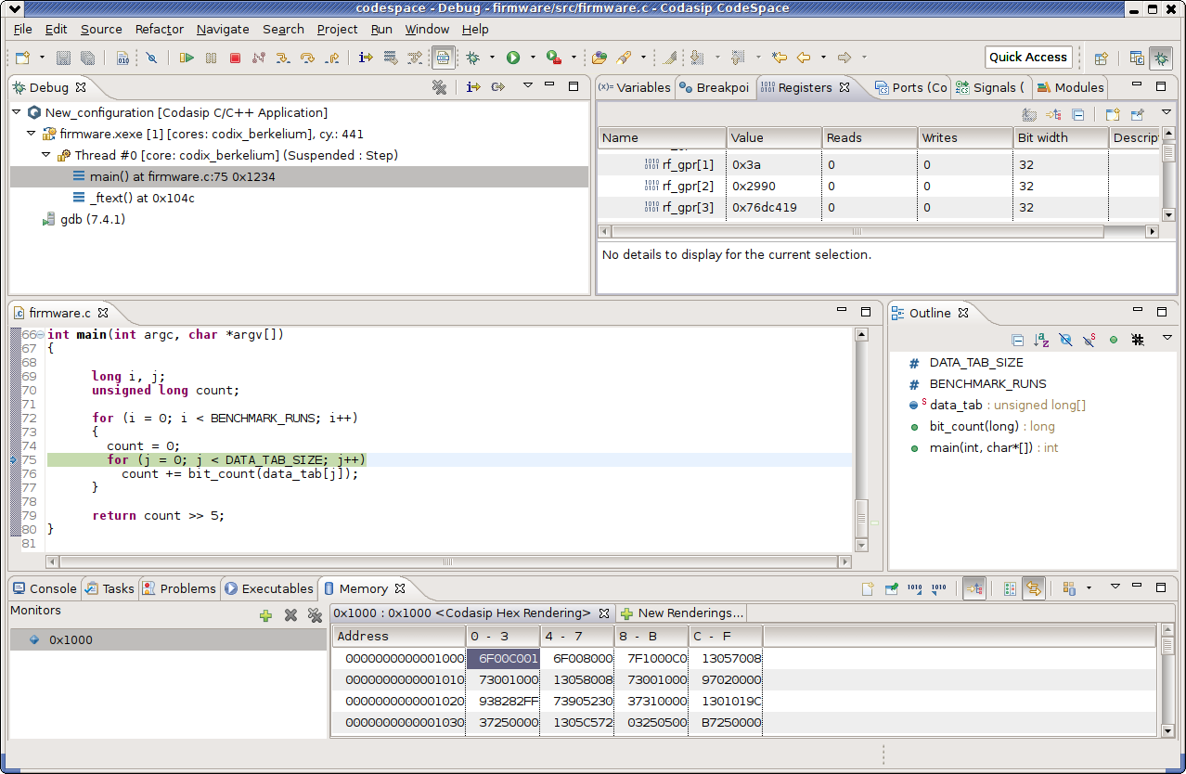
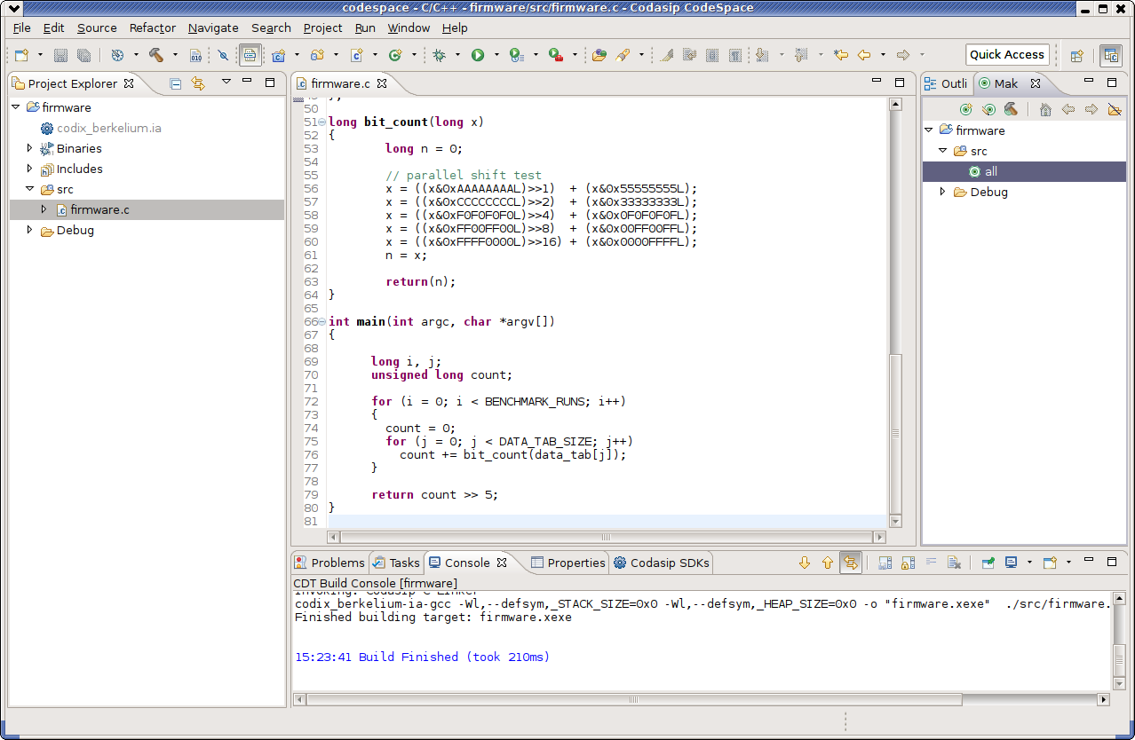
CodeSpace: Eclipse-based IDE
Based on LLVM compiler and debugger
SDK management
You can change the SDK for a software project with just a few clicks
Profiler perspective
Integration with profiler tools directly with editors
Enhanced debugging perspective
You can view ports, signals, or pipeline
On-chip debugging
You can move from ISS to on-chip debugging within the same environment with the same software project

Slide 16
Customer Successes
Our Customers and How We Helped Them

Slide 17
Hangzhou, China
Leader in semiconductor products for HPC (high-performance computing), artificial intelligence and machine learning platforms:
Inference engines for data centers
3D video processing technologies for industrial IoT applications
SR (Simulated Reality)/MR (Mixed Reality) applications with on-chip decision-making capabilities
Vidtoo Technology
Selected product(s):
RISC-V-based, fully configurable and extensible
Single 3-stage in-order execution processor pipeline
Optional caches, IEEE 1149.1 debug, industry-standard bus interfaces
Customer will use it for:
High-performance computing (HPC) chips
Bk3 processor
“After careful consideration, we determined that Codasip offered the best combination of performance, value and design expansion ability. Those traits, plus best-in-class support and the broad ecosystem that the open RISC-V ISA brings, gave us confidence that Codasip was the right choice.”
Thomas Hu, CEO of Vidtoo Technologies

Slide 18
Redwood City, California
Austin, Texas
Leader in artificial intelligence (AI) computing technology based on a unique approach to neural network processing. Mythic’s powerful, yet energy-efficient life-enhancing AI solutions can be pushed into anything, from fitness bands and hearing aids to self-driving cars and security cameras.
Mythic
Selected product(s):
RISC-V-based, fully configurable and extensible
Single 3-stage in-order execution processor pipeline
Optional caches, IEEE 1149.1 debug, branch prediction, industry-standard bus interfaces
Customer will use it for:
Neural networking chips
Bk3 processor
Complete toolset for automated optimization and modification of RISC-V cores
Codasip Studio
“Codasip gave us the flexibility to create a truly unique RISC-V processor, specific to our needs. This saved us the effort to build our own processor from scratch and allowed us to focus on other critical areas of the product development.”
Ty Garibay, VP of Hardware Engineering at Mythic

Slide 19
Seoul, Korea
Leader in analog and power ICs (integrated circuits) for mobile phones. Analog product portfolio includes:
Auto-focus driver IC for smartphones
AMOLED DC-DC converter
Display power driver IC
Haptic driver IC
Dongwoon Anatech
Selected product(s):
RISC-V-based, fully configurable and extensible
Single 3-stage in-order execution processor pipeline
Optional caches, IEEE 1149.1 debug, industry-standard bus interfaces
Customer will use it for:
Motor control IC products
Bk3 processor
“The RISC-V instruction set with custom DSP extensions delivers the performance we require while keeping silicon area to a minimum. The best-in-class Codasip Studio development tools enable us to profile our software and find an optimal set of instructions for our application.”
Jin Park, CTO of Dongwoon Anatech

Slide 20
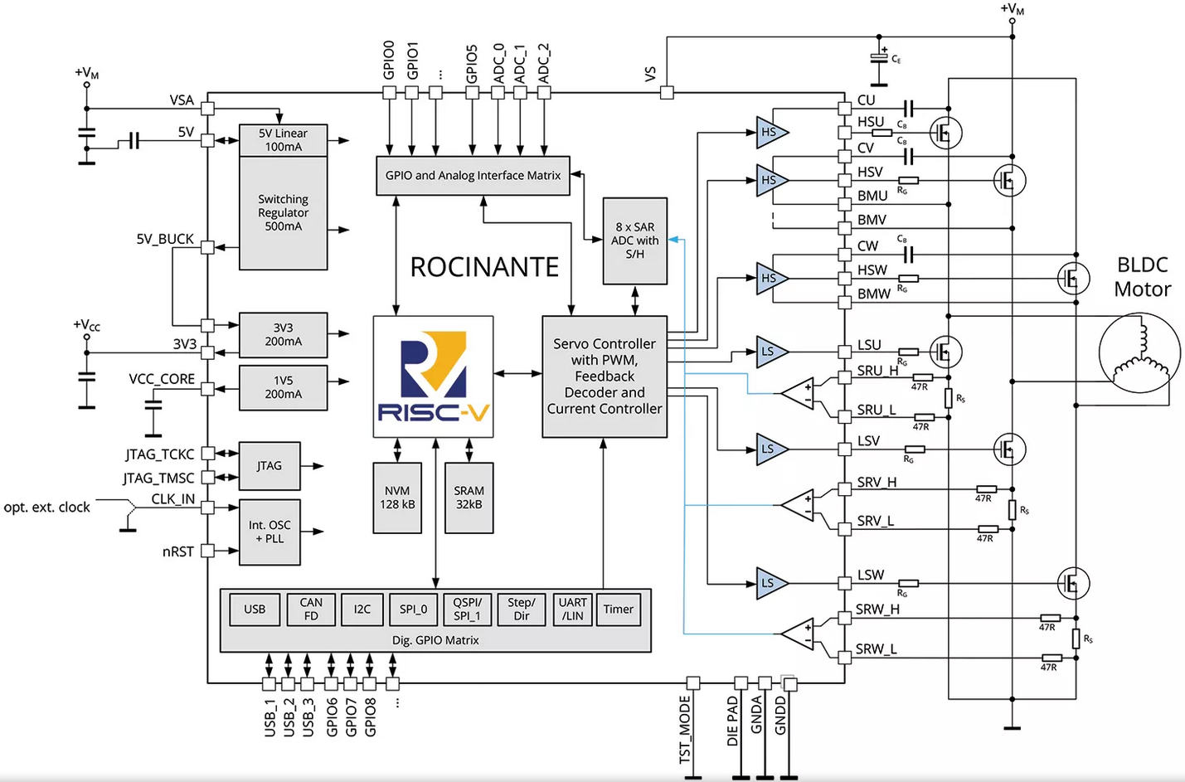
Hamburg, Germany
Global leader in embedded motor and motion control ICs and microsystems.
Trinamic
Selected product(s):
Customer will use it for:
Next generation of motion microcontroller product series
Bk3 processor
Complete toolset for automated optimization and modification of RISC-V processors
Codasip Studio
Optional caches, IEEE 1149.1 debug, industry-standard bus interfaces
RISC-V-based, fully configurable and extensible
Single 3-stage in-order execution processor pipeline
“We opted for RISC-V because the open ISA ensures the longevity our customers require. Among alternatives, Codasip’s Bk3 offered the ideal combination of performance and power efficiency that our applications demand.”
Jonas P. Proeger, Marketing Director of Trinamic

Slide 21
Summary
Codasip provides comprehensive RISC-V IP, from 32bit embedded to 64bit Linux-ready RISC-V cores
Fully verified, complete IP packages
No need to obtain 3rd party packages to start
No need to verify IP
Full-time customer support staff
Codasip Studio enables RISC-V optimization
Unique in the industry

