Slide 1
Open hardware revolution
Calista Redmond
CEO, RISC-V International
@Calista_Redmond

Slide 2
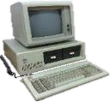
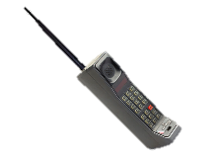
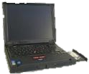
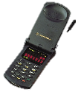
Evolution of the processor industry
1980s
Battle of unique, special-purpose and simple general-purpose chips. Rise of Intel x86 CISC chips for general purpose and slower adoption of RISC chips.
Drawbacks of patent license costs with high barriers to entry
1990s
CPU lifecycle shrinks from years to months, as performance demands accelerate. Moore’s law often cited to double transistors every 12-18 months relative to cost.
Computing needs diverged across implementations, from servers to cars. ARM grows in embedded.
2000s
Performance is critical as physical limits are in sight, age of accelerators and io innovation.
Mobile drives innovation.
Grass roots of open cores such as OpenRISC and OpenSPARC.
Today
Exponential growth from diverse computing need, solved by custom processor development + stakeholder collaboration.
Low barriers to entry with open processor IP. RISC-V specification is free and open.
Notes:
Palm Pilot By Rama & Musée Bolo - Own work, CC BY-SA 2.0 fr, https://commons.wikimedia.org/w/index.php?curid=36959591
Chess computer Morn [CC BY-SA 4.0 (https://creativecommons.org/licenses/by-sa/4.0)]

Slide 3
Global innovation Global collaboration
Cloud and data center applications top cloud providers like Amazon and Alibaba are designing their own chips.
%.
Mobile and wireless continue rapid evolution with each generation of hardware and increased capability.
Automotive is transforming from autonomous vehicles to infotainment to safety, the whole vehicle relies on innovative electronics.
Consumer and IoT devices bring incredible innovation and volume with billions of connected devices being in the next 5-10 years.
Industrial IoT incorporating artificial intelligence in manufacturing and industrial processes.
Memory was the largest semiconductor category by sales with $158 billion in 2018, and the fastest-growing, with sales increasing
Notes:
Memory comment according to Semiconductor Industry Assoc SIA. Sales of DRAM products increased 36.4% and sales of NAND flash products increased 14.8%. Logic ($109.3 billion) and micro-ICs ($67.2 billion)—a category that includes microprocessors—rounded out the top three product categories in terms of total sales.

Slide 4
Industry leverage of RISC-V
Embedded
Microchip Polarfire low power FPGA SOC for Military and aerospace applications requiring realtime, highly secure
Machine Learning / AI
Alibaba revealed 16-core high performance RISC-V chip for AI, IOT, and 5G applications. They have also shared a low-power RISC-V design
InCore Semiconductors of India laid out plans for a family of RISC-V based cores as well as deep-learning accelerators and SoC design
Sony Semiconductors detailed plans for AI integration onto image sensors at RISC-V Tokyo Day
SWITCH SCIENCE KK AI camera with RISC-V CPU, M5StickV (Japan)
High Performance Computing
The European Processor Initiative picks RISC-V for accelerators
Internet of Things
Greenwaves offers ultra-low-power, high-performance GAP8 APs to enable AI in battery-powered IoT devices. GreenWaves is a key contributor to the RISC-V–based PULP (parallel ultra-low-power processing platform)
GigaDevice launched world’s first general-purpose microcontroller based on RISC-V for the IOT market.
Virtual reality, augmented reality, AR/VR
Facebook’s Oculus team has been a strong supporter of RISC-V, sharing the importance of the technology in AR/VR application
Wearables
Huami’s Huangshan 1S Processor on 7nm. Huami is a top wearable manufacturer in the world today
Wireless
Samsung plans RISC-V cores in the mmWave RF portion of its 5G cellular modems
Notes:
Microchip https://www.militaryaerospace.com/computers/article/14074714/embedded-computing-fpga-lowpower
Alibaba https://www.eetimes.com/alibaba-reveals-16-core-risc-v-chip/
Gigadevice EE Times 26 Aug 2019
InCore EE Times July 2018
Samsung https://twitter.com/diodesign/status/1204482962072330240

Slide 5
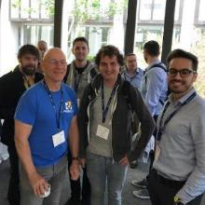
A community of many experts and stakeholders
Services Fab, design services
Chip SoC, IP, FPGA
I/O Memory, network, storage
Universities and Research
Software Dev tools, firmware, OS
Industry cloud, mobile, HPC, ML, automotive
Press and Analysts
Investors and Funding sources
Individual Advocates
Notes:
Membership in RISC-V International continues to grow rapidly, now at more than 550 members across 50 countries, more than doubling from 2019.

Slide 6
Functional innovation on RISC-V
Acceleration
NVIDIA is expanding RISC-V beyond microcontrollers to input/output core in an inference accelerator part RC18, a high-performance accelerator for deep-learning inference workloads. Input output and serial functionality is handled by a single master core – built on the RISC-V ISA.
Memory and Storage
Western Digital has committed to use RISC-V in all of their storage processors
Macronix is bringing RISC-V memory centric solutions that combine memory with a RISC-V accelerator processor to consumer implementations
Security
HexFive creator of MultiZone™ Security for multi-domain secure execution environment for RISC-V, also an AdaCore partner
Microchip mid-range PolarFire FPGA for low power, thermal efficiency, and defense-grade security in embedded computing systems
Root of Trust
Google launched OpenTitan together with Western Digital, ETH Zurich, G+D Mobile Security, Nuvoton Technology for an open source microprocessor (the lowRISC Ibex, a RISC-V-based design), cryptographic coprocessors, a hardware random number generator, a sophisticated key hierarchy, memory hierarchies for volatile and non-volatile storage, defensive mechanisms, IO peripherals, secure boot, and more
Design support
Imperas and UltraSOC providing tools and verification support
Andes IDE for software development based on Eclipse for embedded applications.
SmartDV Technologies ,Verification IP supplier, TileLink VIP to verify the TileLink chip-scale interconnect standard.
AdaCore bringing Ada and Spark programming to RISC-V
Notes:
NVIDIA https://abopen.com/news/nvidia-turns-to-risc-v-for-rc18-research-chip-io-core/
Macronix https://www.forbes.com/sites/tomcoughlin/2020/01/13/storage-and-memory-at-the-2020-ces-part-2/#6a21b31d4052
Google https://www.scmagazineuk.com/google-looks-open-source-silicon-solve-root-trust-conundrum/article/1665164
DSA Domain-specific accelerators (DSAs) provide higher performance per watt than a general-purpose processor by optimizing the specialized function it implements. Examples of DSAs include compression/decompression units, random number generators and network packet processors.
Design https://www.eeweb.com/profile/max-maxfield/articles/introducing-risc-v-and-risc-v-tools

Slide 7
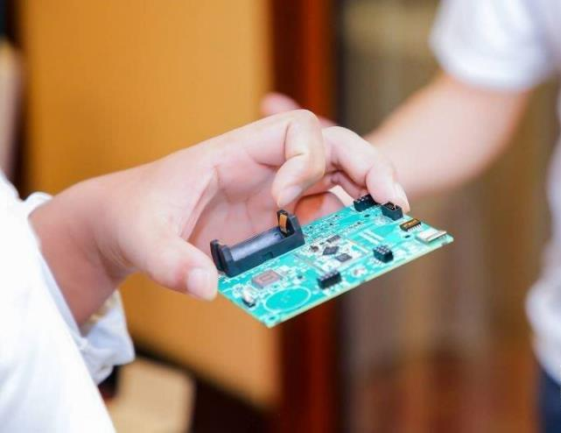
Global partners and supply chain Global opportunity

Slide 8
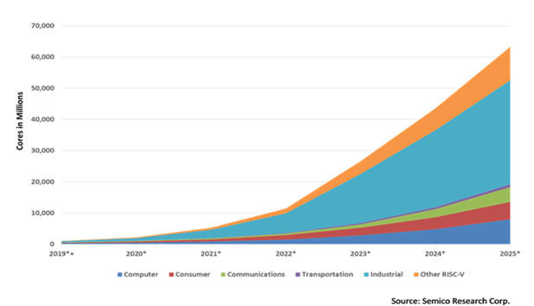
Forecasting global adoption
62.4 billion RISC-V CPU cores
RISC-V is poised to significantly grow rapidly over the next five years.
Semico Research predicts the market will consume a total of 62.4 billion RISC-V CPU cores by 2025, with the industrial sector to lead with 16.7 billion cores.
Notes:
Notable Key Statistics from Semico’s Report
The market will consume a total of 62.4 billion RISC-V CPU cores by 2025, with the industrial sector forecasted to be the largest segment with 16.7 billion cores.
Semico estimates that segments including the computer, consumer, communication, transportation and industrial markets will see a 146.2 percent compound annual growth rate (CAGR) on average between 2018 and 2025.
Semico estimates that the communication sector will see the largest CAGR due to the deployment of 5G and the multitude of products and applications that will be enabled with the adoption of 5G technology.
Transportation is estimated to have the second-fastest CAGR due to the automotive industry’s growing focus on electrification and the increased adoption of CPU-based systems for safety, in-cabin experiences, driver assistance and wireless communications.

Slide 9
China / Taiwan
more than 200 members have joined the CRVA and CRVIC associations as well as 60 RISC-V International members. Over the last year, we led discussions in more than a dozen cities and hosted a day of talks at the World Internet Conference. In November, we hosted 500 attendees at the China RISC-V Forum.
Notes:
RISC-V International Open Source Laboratory (RIOS Laboratory) research at Tsinghua-Berkeley Shenzhen Institute (TBSI) by the University of California at Berkeley and Tsinghua University. June 2019
Alibaba processor achieves 7.1 Coremark/MHz at a frequency of 2.5GHz on a 12nm process node, which is 40 percent more powerful than any RISC-V processor produced to date. – EE/Times July 2019
GigaDevice launched world’s first general-purpose microcontroller based on RISC-V for the IOT market. – EE Times 26 Aug 2019
Huami’s Upcoming Huangshan 1S Processor Said To Be Built On 7nm. Huami is one of the top wearable manufacturers in the world today released its first self-developed RISC-V based Huangshan 1 processor last year. August 27, 2019
In Taiwan, the RISC-V Taiwan Alliance has hosted it’s first forum of 140 participants with a larger audience anticipated in June in concert with Computex http://www.twiota.org/RISC-V/LatestNews.aspx

Slide 10
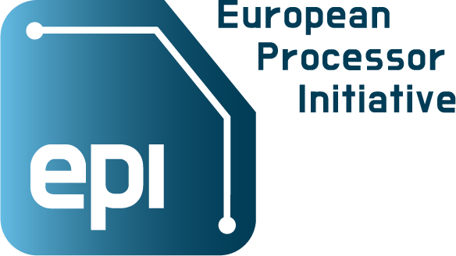
Europe
The European Processor Initiative has declared RISC-V as a key architecture for the next generation of HPC processors and systems focused on acceleration. RISC-V is deeply involved in university adoption of RISC-V through EU universities and FOSSi, as well as launch of our HPC Special Interest Group with Barcelona Super Computing Center.
Notes:
The EU Is Progressing With RISC-V For A European Supercomputer. RISC-V was chosen as the basis for the supercomputer, and the processor and platform developed with the European Processor Initiative (EPI) consortium. – TechNews. 5 June 2019
SERV CPU exemplifies the modularity of RISC-V to create an extremely small CPU running standard RISC-V software – Qamcom 15 Sep 2019

Slide 11
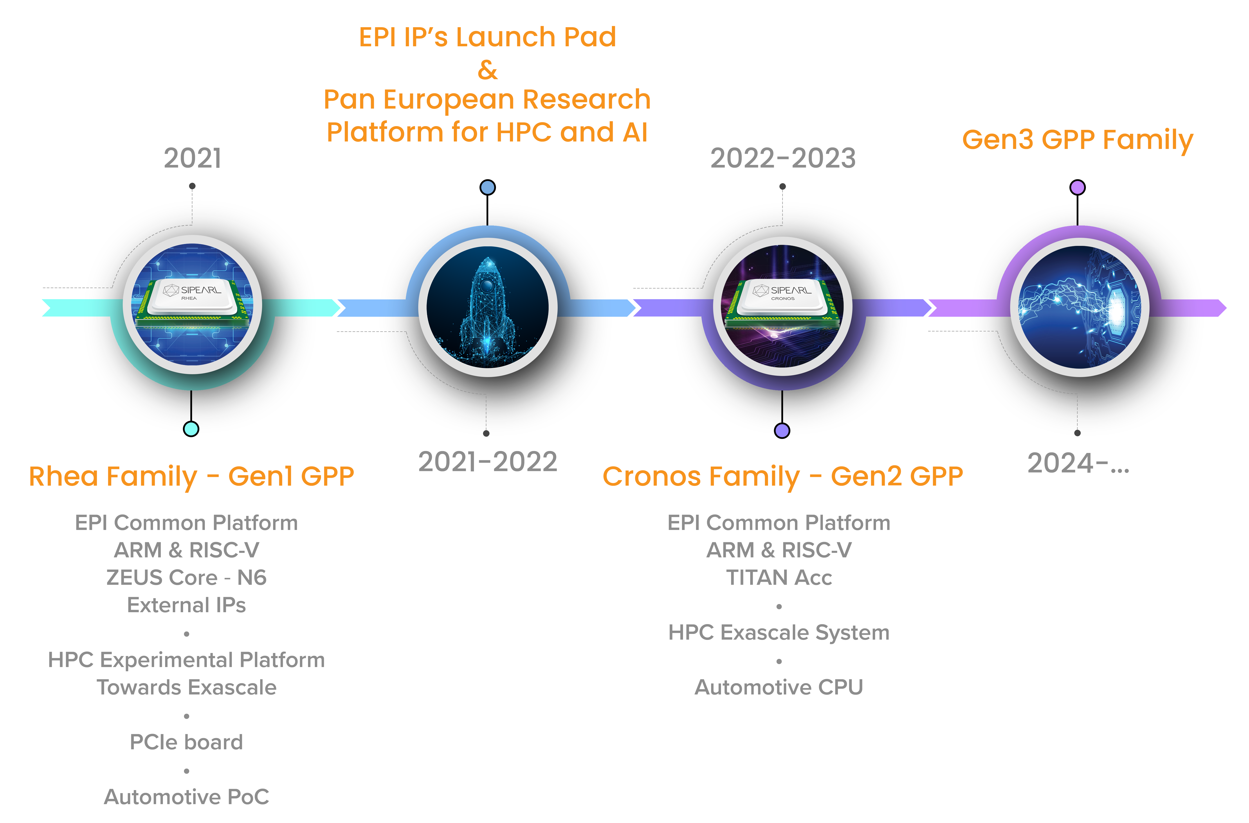
RISC-V Europe HPC leadership
European Processor Initiative for Accelerator
The Accelerator stream will develop and demonstrate fully European processor IPs based on the RISC-V ISA, providing power efficient and high throughput accelerator tiles within the GPP chip.
Notes:
57 members in Europe
https://www.european-processor-initiative.eu/accelerator/

Slide 12
HPC and beyond with RISC-V
Barcelona Supercomputing Center Development of RISC-V ‘Lagarto’ Processor
Lagarto, built with TSMC’s 65-nanometer transistors, is the first open source ISA chip developed in Spain, coordinated by BSC. The chip has performed better results than expected and is key for center’s strategy to become a benchmark in European open source hardware.
RISC-V European Space platform
The Horizon 2020 European project De-RISC (Dependable Real-time Infrastructure for Safety-critical Computer) to develop a hardware and software platform based around the RISC-V ISA for space and aviation.
Notes:
https://www.hpcwire.com/off-the-wire/bsc-coordinates-development-of-risc-v-lagarto-processor/
https://www.eenewseurope.com/news/risc-v-fully-european-platform-space

Slide 13
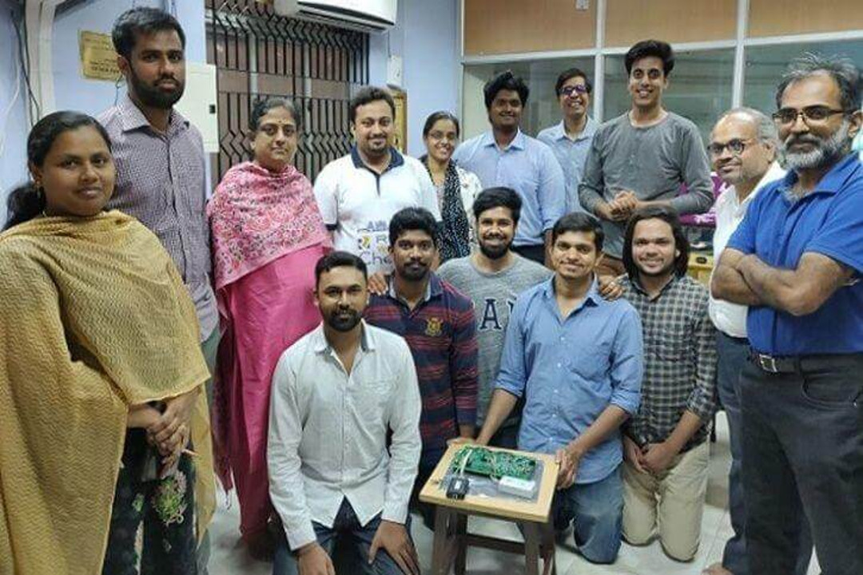
India
2014 witnessed the funding of 6 RISC-V processors through the Shakti project, led by RISE group at IIT Madras. RISC-V has been widely declared the national architecture of India with deep University and professional training support.
Notes:
https://shakti.org.in/index.html
InCore Semiconductors of India laid out its plans for a family of RISC-V based cores as well as deep-learning accelerators and SoC design – EE Times July 2018
~1400 participants in largest ONLINE 5-day VLSI workshop using opensource EDA tools with 48 India universities – July 2019
India is ready to test its own line of RISC-V desktop CPUs – Notebook Check July 2019
July 2019 Shakti processors ready for applications. https://www.tomshardware.com/news/india-shakti-cpu-processors-sdk-risc-v,39781.html

Slide 14
Japan
Momentum is continuing to grow in our engagement with a 50% jump at our 2019 Tokyo day to 360 registered attendees. Hitachi and Sony Semiconductors are RISC-V leaders in Japan.
Notes:
UEC Pham Lab. 64-bit Rocket U5 Experimental Chip -- Tokyo January 2019
Realtime Operating System conforms to μITRON4.0 Specification Standard with available Ubiquitous AI Corporation extensions -- Ubiquitous AI Corporation June 2019
Sony LSI Design Executive Deputy President Hideki Yoshida's presentation at RISC-V Day Tokyo 2019 “Future of Image Sensing with RISC-V" details Sony plans of AI integration onto image sensors – 30 Sep 2019 Sony Semiconductors

Slide 15
North America
North America. Industry adoption has taken off with millions of cores shipping from NVIDIA, Western Digital, SiFive, and others. In Automotive, we see NVIDIA leverage of RISC-V for security processors.
Notes:
Western Digital releases their RISC-V Cores to the world… they will transition their consumption of silicon over to RISC-V, putting one Billion RISC-V cores per year into the marketplace – Hackaday. 13 February 2019
AWS Announces RISC-V Support in the FreeRTOS Kernel enabling embedded developers to create IoT applications on the officially supported FreeRTOS kernel for microcontrollers – AWS 26 February 2019
SiFive Celebrates Historic 100 Design Wins Milestone – SiFive 6 June 2019
NVIDIA Turns to RISC-V for RC18 Research Chip IO Core. – AB Open 4 Sept 2019
Nvidia is using RISC-V for its security processor, and programming is handled via Ada/SPARKin NVIDIA DRIVE AGX Orin https://www.electronicdesign.com/markets/automotive/article/21121197/ada-and-riscv-secure-nvidias-future

Slide 16
Pakistan
On the road to declaring RISC-V their national architecture, two of the biggest gatherings ever of 3000+ in Pakistan for two SiFive tech symposiums – Oct 2019

Slide 17
Welcome to the RISC-V revolution!
RISC-V International is a non-profit entity serving members and the industry
Our mission is to accelerate RISC-V adoption with shared benefit to the entire community of stakeholders.
RISC-V is the open-source hardware Instruction Set Architecture (ISA)
Frozen base user spec released in 2014, contributed, ratified, and openly published by RISC-V International
Drive progression of ratified specs, compliance suite, and other technical deliverables
Grow the overall ecosystem / membership, promoting diversity while preventing fragmentation
Deepen community engagement and visibility
Notes:
Talk about what an ISA is….

Slide 18
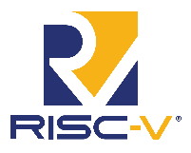
Notes:
The ecosystem is strong, and growing

Slide 19
More than 580 RISC-V Members across 50 Countries Around the World
66 Chip SoC, IP, FPGA
8 I/O Memory, network, storage
24 Services Fab, design services
24 Software Dev tools, firmware, OS
29 Industry Cloud, mobile, HPC, ML, automotive
55 Research Universities, Labs, other alliances
350+ Individual RISC-V developers and advocates
June 2020

Slide 20
Programs deliver value of membership
Technical Deliverables
Guard against fragmentation
Manage and progress technical deliverables through work groups and development team
Administration process and initiation of technical work groups
Compliance + Verification
Develop self serve testing and compliance program
Develop compliance verification formal service
Visibility
Drive constant drumbeat of member and RISC-V visibility through multiple media
Engage in industry events and host RISC-V events
Strategic visibility through industry forums, analysts, and media
Learning + Talent
Develop multi-level learning modules
Connections for universities, professors, and course material
Badge and skill level certification
Online and event forums for talent matching
Advocacy + Outreach
Establish technical ambassador program
Geographic and domain specific advocate-led engagement via events and opportunities
Establish alliances with other organizations
Marketplace
Provide online marketplace of providers and products
Offer RFP matching to members

Slide 21
2020 Progress!
Technical deliverables. We're aligning our working groups and committees on key technical elements needed to build and innovate solutions for industry applications, from embedded to enterprise, from micro-controller to cloud servers.
Compliance. We've launched our first compliance suite and are building our first compliance test to ensure solutions are compliant to the base RISC-V Instruction Set Architecture (ISA). Visibility. We're focused on amplifying the progress of our members as well as the momentum of RISC-V International through our relationships with press and analysts, events, social media, blogs, and original content.
Academia and learning. Our programs are connecting universities infusing RISC-V into common curriculum as well as enabling and supporting professional training providers to engage all levels of learning.
Developer advocacy. We're supporting more than 3,600 members of our 30 local and regional RISC-V groups. We partner closely with geographic groups as well as industry and domain experts ranging from HPC to security. We have also launched the RISC-V Ambassador program to ensure connection of RISC-V technical experts with their peers around the world.
Marketplace exchange. We're building a scalable platform to host not only RISC-V innovations available to the community, but also to enable and support the many technical forums that surround cores, SoCs, developer boards, software stacks, design tools and more.

Slide 22
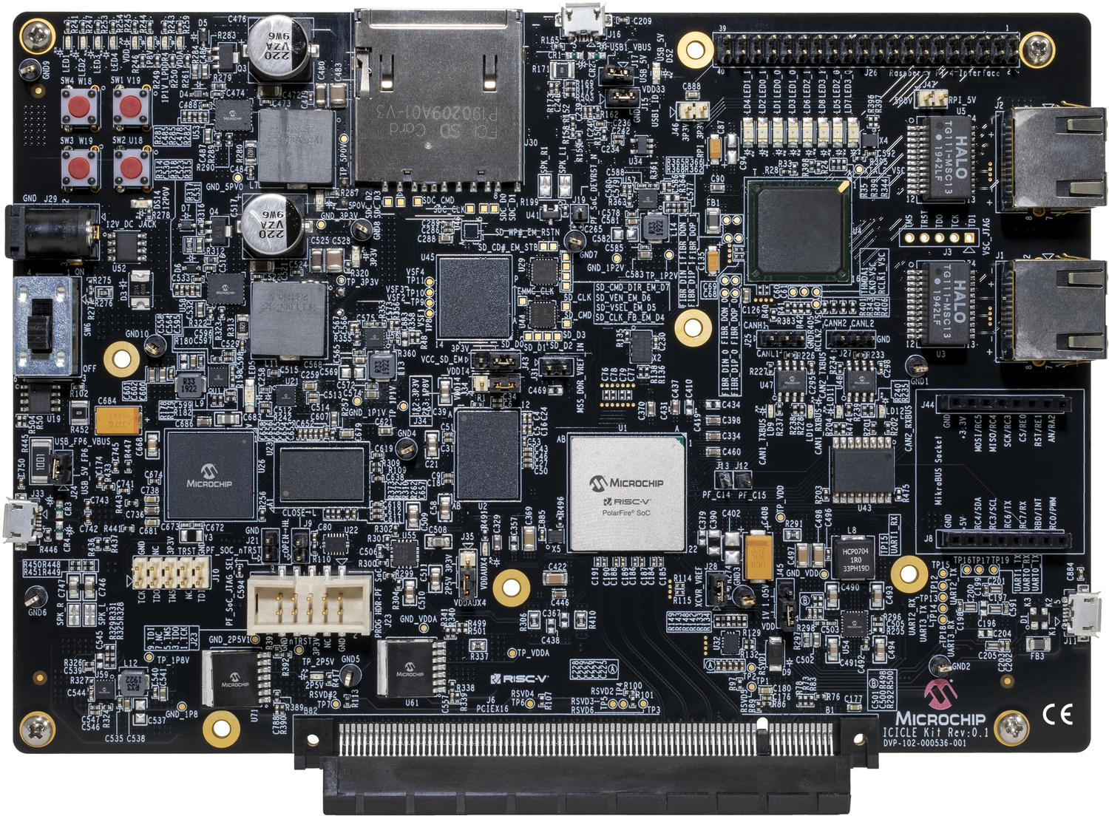
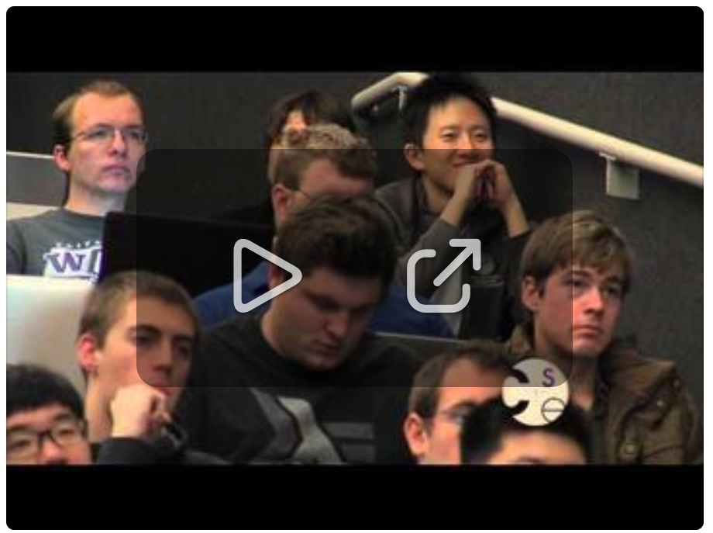
2020 product announcements
Krste Asanovic At Berkeley, we're packaging our open-source IP and tooling as Chipyard (https://chipyard.readthedocs.io/en/latest/) and are working with OpenROAD to include a path to that flow. SiFive has been open-sourcing a bunch of RocketChip, Chisel/FIRRTL updates, and new build tools at CHIPS Alliance, some of which the Berkeley team are folding into Chipyard too.
PolarFire SoC Icicle Kit
A low-cost dev kit for Microchip's PolarFire SoC, a low-power FPGA integrated with a complete hardened quad core 64-bit RISC-V processor(451 kB)
Get up-to-speed quick with the RISC-V Reader riscvbook.com
Instruction Sets Want To Be Free: A Case for RISC-V

Slide 23
Engaged engineers are domain experts Drive technical priorities in 25+ focus areas
Compliance
Technical Deliverables
Opcode Space Mgmt Standing Committee
V Extension (Vector Ops) Task Group
Software Standing Committee
Cryptographic Extension Task Group
Base ISA Ratification Task Group
Debug Specification Task Group
Privileged ISA Spec Task Group
Fast Interrupts Spec Task Group
UNIX-Class Platform Spec Task Group
Memory Model Spec Task Group
Formal Specification Task Group
Processor Trace Spec Task Group
Trusted Execution Env Spec Task Group
Sv128 Specification Task Group
B Extension (Bit Manipulation) Task Group
Virtual Memory Task Group
J Extension (Dynam. Translated Lang) Task Group
Compliance Task Group
P Extension (Packed-SIMD Inst) Task Group
Zfinx Task Group
+ Security Committee, HPC Special interest group, and proposed Safety Task Group
Notes:
Emphasize all of the great things that have been accomplished – Need to take it to the next level! Amp it up!!!
Talk about the synergies with the Linux Foundation. We will be able to focus on our key objectives instead of having to deal with the day to day back-end office tasks.
Talk about building the value proposition for members

Slide 24
Engaged engineers are domain experts Drive technical priorities in 30+ focus areas
Standing Committees
Task Groups
Compliance
Technical Deliverables
SIG
RISC-V Board of Directors
RISC-V Technical Steering Committee
Security
Software
Unprivileged
Spec
Privileged
Spec
Debug &
Trace
Formal Spec &
Compliance
TEE
Unix Platform Spec
Base ISA
Memory Model
Processor
Trace
Compliance
Crypto
J Extension
Security Response Team
Software Overlay
Virtual
Memory
Debug
Formal Spec
V Extension
B Extension
Config
Structure
Nexus
P Extension
Fast Interrupt
Zfinx TG
Active
Proposed
Functional Safety
Soft CPU
High Performance Computing
Graduated

Slide 25
Software support
Open Source GNU toolchain, LLVM, QEMU virtual machines
Operating Systems
Linux high end (64 bit), Yocto (embedded distro) and OpenSuse
Fedora (Red Hat) support coming in 2Q 2020
AliOS, like Linux/Android from Alibaba for RV 64 bit
32 bit RTOS
FreeRTOS (AWS RISC-V Support in FreeRTOS Kernel for embedded IoT applications on supported kernel for microcontrollers)
Zephyr
VxWorks RTOS from Windriver now supports RISC-V for embedded
ThreadX (AndesCore)
SafeRTOS
SylixOS; an opensource embedded real-time operating system
RT-Thread; an open source RTOS for embedded
AliOS-Things; a 32 bit RTOS from Alibaba
Ubiquitous AI Corporation:TOPPERS-Pro/ASP RTOS
Commercial SW
Lauterbach
Segger
IAR
Micrium
ExpressLogic
Ashling
Notes:
SafeRTOS (this is a cool one; https://www.prweb.com/releases/safertos_now_supports_risc_v_a_new_announcement_from_wittenstein_high_integrity_systems/prweb16443406.htm)

Slide 26
Testing RISC-V Architecture Compliance
The RISC-V Compliance Framework Version 0.1 is now available https://github.com/riscv/riscv-compliance/
Compares arbitrary models against a reference signature
Currently covers RV32IMC and RV64IMC unprivileged spec only
Work on Version 0.2 is underway
The RISC-V spec allows many architectural implementation choices, a new repository created to describe implementation configurations that the Framework will use to select & configure tests https://riscv-config.readthedocs.io/en/latest/
Notes:
Compares arbitrary models against a reference signature
e.g. your implementation, RISC-V CSAIL formal model, ovpsim, spike, etc.
Currently covers RV32IMC and RV64IMC unprivileged spec only
Nearly 100% coverage for RV32
Work on Version 0.2 is underway
New test specification with improved macro support for writing tests
Configure to match larger choice of architectural options
Examples: privilege levels, extensions, HW unaligned access support, CSRs and WARL field implementation
Allow comparison of two arbitrary models, formal model vs. your implementation

Slide 27
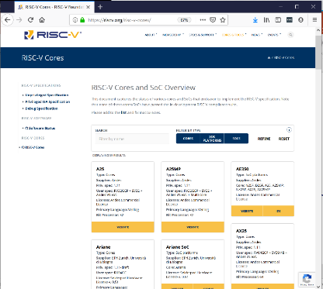
Visible RISC-V momentum
Visibility
Online RISC-V marketplace
Marketplace
RISC-V and Industry events at global, regional, and local levels
Webinars, blogs, and social amplification. Engaged Press + Analysts
Steady cadence of news, events, and engagement
Local and Regional community initiatives for engineers
https://riscv.org/risc-v-cores/
Notes:
2017 saw 480, 2018 saw 1100 attendees, and 2019 was 1670 attendees
Our online marketplace already has 86 listings

Slide 28
The community and marketplace of open hardware
RISC-V Alliances
Linux Foundation
Pakistan
RISC-V Japan Alliance
ChipsAlliance
FOSSi Foundation
RIOS Lab
Taiwan RISC-V Alliance (RVTA)
OpenForum Europe (OFE)
GlobalPlatform
OpenHW Group
CRVA (China)
CRVIC (China)
Beijing Open Source Silicon Innovation Center
Cores and SOCs
Rocket. UEC Pham Lab. 64-bit Rocket U5 Chip
BOOM from Berkeley
Ariane 64 bit CPU from ETH Zurich
Piccolo CPU for embedded and IOT from Bluespec
Out-of-order superscalar processor RSD from University of Tokyo
Ibex 32 bit RISC-V CPU core from lowRISC
SweRV core open sourced from Western Digital
zGlue release rapid turnaround chiplet-based GEM ASIC from AntMicro
RISC-V Cores
RISC-V commercial IP core providers: SiFive, Andes Technology, Codasip, Bluespec, Cortus, Cloudbear, Nuclei
In-house cores: Esperanto, Western Digital, NVIDIA, Alibaba
List online: www.riscv.org/risc-v-cores
Additional open and proprietary
SiFive
Andes
Rumble Development
Esperanto
Greenwaves
NXP
GigaDevice
Microchip
Notes:
UEC Pham Lab. 64-bit Rocket U5 Experimental Chip Japan

Slide 29
Come together. Right Now.
Learning + Talent
Advocacy + Outreach
RISC-V Ambassador program
https://riscv.org/risc-v-ambassadors/
Meetups (3,600+ Members in 22 cities) https://riscv.org/meetups/
Global Online Forum Sep 3!
December RISC-V summit
Numerous Industry events
https://riscv.org/events/upcoming-events/
Education Resources at all levels
Curriculum Adoption
by universities
Online Education to increase skills globally
New courses in development
https://riscv.org/educational-materials/
Notes:
New Meetup Groups popping up monthly – Great source of networking for engineers
Online catalogue of curriculum presently at 29 listings and growing

Slide 30
Three membership options to join us
Premier Member Benefits
Strategic level benefits plus…
Board seat and Technical Steering Committee seat included for $250k level
Technical Steering Committee seat included for $100k level
Summit speaker session
Solution provider listing
2 case study / blogs per year
4 social media spotlights
Spotlight member profile
Inclusion in event promotions
Strategic Member Benefits
Community level benefits plus…
Use of RISC-V Trademark for commercialization
3 Board reps elected for tier, includes Premier members that do not otherwise have a board seat.
Eligible to lead workgroup and/or committee
Solution provider listing
1 social media spotlight
Community Member Benefits
Accelerated development, reduced risk through open source, ratified ISA.
Eligible to participate in workgroups, influence strategy and adoption
6 support programs in Technical Deliverables, Compliance, Visibility, Learning, Advocacy, and Marketplace
1 Community Organization rep, 1 Community Individual Board rep
Member logo / name listing in website
Event registration discount
Premier Requirements
Membership open to any type of legal entity, not open to individual members
$250k Annual membership fee that includes Board seat and TSC seat
$100k Annual membership fee that includes TSC seat
Strategic Member Requirements
Membership open to any type of legal entity, not open to individual members
Annual membership fee based on employee size
5,000+ employees $35k
500-5,000 employees $15k
<500 employees $5k
Community Requirements
Membership open to academic institutions, non-profits, and individuals not representing a legal entity
No annual membership fee
https://riscv.org/membership-application/
Note: An organization may not hold more than one seat on the Board or TSC

Slide 31
Calista Redmond
CEO , RISC-V International
www.linkedin.com/company/risc-v-foundation
www.linkedin.com/in/calistaredmond
Join the Revolution
@risc_v
@Calista_Redmond
www.riscv.org

