Slide 1
RISC-V Unconstrained
Technology. Opportunity. Community.
Calista Redmond
CEO, RISC-V International

Slide 2
Thank you to our generous RISC-V Summit sponsors

Slide 3
The RISC-V community is focused on growing opportunities

Slide 4
By 2025, 40% of application-specific integrated circuits (ASICs) will be designed by OEMs, up from around 30% today. Custom ICs Based on RISC-V Will Enable Cost-Effective IoT Product Differentiation Gartner, June 2020
Source: Gartner
Notes:
https://www.gartner.com/en/documents/3986115/report-highlight-for-market-trends-custom-ics-based-on-r

Slide 5
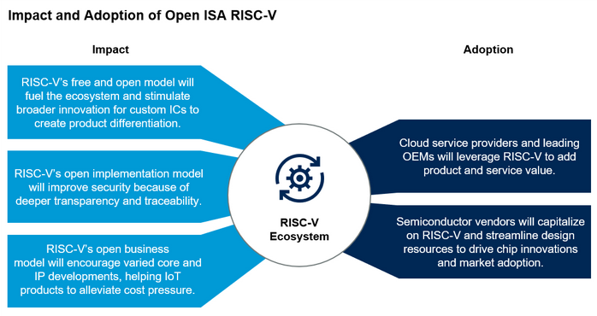
Source: Gartner ID: 46523_C
Notes:
https://www.gartner.com/document/3981573?ref=solrAll&refval=264798788

Slide 6
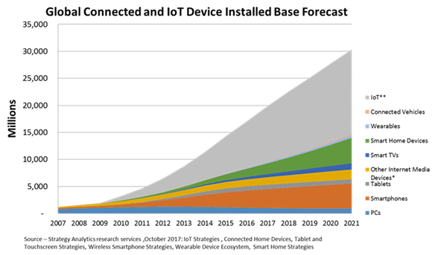
30 billion connected and IoT devices demand security and custom processors
Source: Strategy Analytics

Slide 7
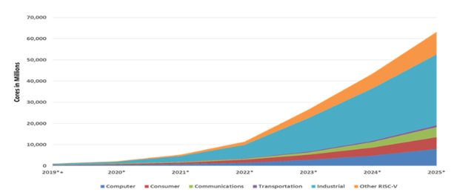
Rapid RISC-V growth over next five years led by industrial
62.4 billion RISC-V CPU cores by 2025
Semico Research predicts the market will consume 62.4 billion RISC-V CPU cores by 2025, a 146.2% CAGR 2018-2025. The industrial sector to lead with 16.7 billion cores.
Source: Semico Research Corp
Notes:
"Companies are turning to RISC-V solutions for a wide variety of applications and to address a wide range of performance and volume requirements," says Semico president Jim Feldhan.

Slide 8
RISC-V IP, SW, and Tools build momentum
The total market for RISC-V IP and Software is expected to grow from to $1.07 billion by 2025 at a CAGR of 54.1%
Source: Tractica
Notes:
https://riscv.org/wp-content/uploads/2019/12/12.11-14.20a9-Joshi-Tractica-Processor-IP-Showcase-with-Andes-Technology-CHIPS-Alliance-Codasip-Shakti-Project-SiFive-Syntacore-OpenHW-Group-1.pdf
https://tractica.omdia.com/research/risc-v-processors/

Slide 9
RISC-V adoption spans industries and workloads
Cloud and data center top providers like Amazon and Alibaba are designing their own chips.
Mobile and wireless continue rapid evolution with each generation of hardware and increased capability.
Automotive is transforming from autonomous vehicles to infotainment to safety, the whole vehicle relies on innovative electronics.
Consumer and IoT devices bring incredible innovation and volume with billions of connected devices in the next 5-10 years.
Industrial IoT incorporating artificial intelligence in manufacturing and industrial processes.
Memory was the largest semiconductor category by sales with $158 billion in 2018, and the fastest-growing.
Notes:
The RISC-V community is already making an impact across industries.
In automotive, we’ve seen progress in safety and security from NVIDIA and have worked with them to form the Functional Safety Special Interest Group in RISC-V
In HPC, we continue to work with the European Commission on RISC-V acceleration for super computers through the EPI initiative as well as sharing insights on open source approaches to technology to reduce risk and dependency on any one entity.
The future for RISC-V is incredibly bright in areas with legacy architectures as well as new arenas with growing adoption of custom processors.
In the memory semiconductor space, growth projections range from 6-16% on this $100Billion market led by Flash, Telecomm, and Consumer electronics.
Industrial and Automotive are close behind as we bring more compute and memory solutions to safety, automated driving, infotainment and more.
IOT continues to be hot growth area. IoT devices are includes a broad range of electronics, household appliances, automotive, and commercial IoT for manufacturing, logistics and transportation. Business insider forecasts more than 64 billion IoT devices by 2026, driving a $15 trillion market.
Predictions from Semico predict RISC-V cores to climb to 62.4 billion by 2025 across industrial, transportation, communications, consumer and other compute implementations.
We’re continuing to collaborate not only within our community, but externally across entities such as Global Platform for security standards as well as 15 other alliances including alliances for research, education, industry adoption, software support, and regional RISC-V groups.

Slide 10
More than 750 RISC-V Members
across 50 Countries
85 Chip SoC, IP, FPGA
3 I/O Memory, network, storage
11 Services Fab, design services
35 Software Dev tools, firmware, OS
4 Systems ODM, OEM
12 Industry Cloud, mobile, HPC, ML, automotive
56 Research Universities, Labs, other alliances
500+ Individuals
RISC-V developers and advocates
In 2020, RISC-V membership has grown by more than 60%
October 2020

Slide 11
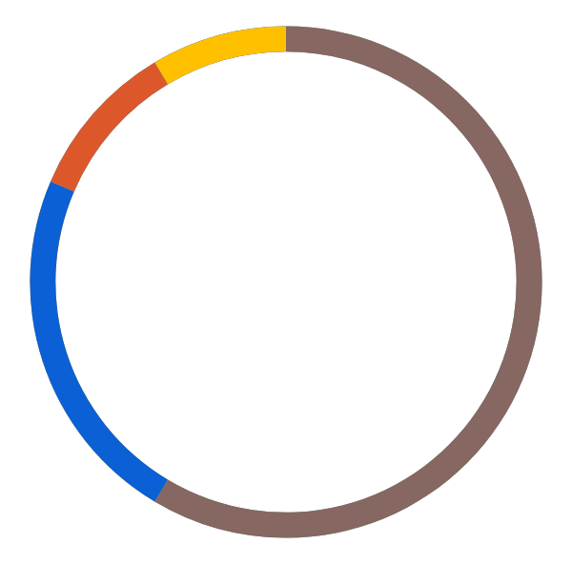
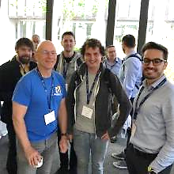
Dedicated Community
Services Fab, design services
Chip SoC, IP, FPGA
I/O Memory, network, storage
Universities and Research
Software Dev tools, firmware, OS
Industry cloud, mobile, HPC, ML, automotive
Press and Analysts
Investors and Funding sources
Individual Advocates
Notes:
Our community is incredible.
Today we have more than 690 members spanning 50 countries. Our global community is distributed about 1/3 in North America, 1/3 in Europe, and 1/3 in APAC.
RISC-V has seen tremendous engagement and collaboration across our 37 technical and industry committees and workgroups.
Our dedicated community is driving progress.
We’re gaining momentum in open technical deliverables,
our members are growing their commercial success,
entrepreneurs are starting new companies,
investors are funding RISC-V companies,
multi-nationals are building beyond microcontrollers,
public institutions are specifying RISC-V,
Students and professors are integrating RISC-V in research and studies
We’re rapidly cultivating an ecosystem of stakeholders across all dimensions

Slide 12
Industry innovation on RISC-V
Hardware
– RV64, multi-heart CPUs, vectors, bit manipulation, hypervisors, debug mode –
AI SoCs
Application processors
Software
Linux
Drivers
AI Compilers
Hardware
– RV32, privilege modes, interrupts –
IoT SoCs
Microcontrollers
Software
RTOS
Firmware
Hardware
– RV32 –
Proof of Concept SoCs
Minion processors for power management, communications, …
Software
Bare metal software
Hardware
ISA Definition
Test Chips
Software
Tests
Complexity
2010 – 2016
2017 – 2018
2019 – 2020
2021

Slide 13
Incredible industry progress
The European Processor Initiative finalized the first version of its RISC-V accelerator architecture, named EPAC, and will deliver the first EPAC Test Chip in 2021.
The RIOS Lab announced PicoRio, an affordable RISC-V open source small-board computer available in the first half of 2021.
Imperas announced the first RISC-V verification reference model with UVM encapsulation.
Microchip released the first SoC FPGA development kit based on the RISC-V ISA.
Saifang Technology released the world’s first RISC-V AI visual processing platform
SiFive unveiled the world’s fastest development board for RISC-V Personal Computers.
Micro Magic announced an incredibly fast 64-bit RISC-V core achieving 5GHz and 13,000 CoreMarks at 1.1V.
Notes:
The European Processor Initiative partners have finalized the first version of its RISC-V accelerator architecture, named EPAC, and are working towards the delivery of the first EPAC Test Chip in 2021. Link
The RISC-V International Open Source Laboratory (also known as RIOS Lab), announced the PicoRio open-source project. The PicoRio will be a RISC-V-based small-board computer available at an affordable price point, and will be available to ship in the first half of 2021. Link
Imperas announced the first reference model with UVM encapsulation for RISC-V verification.
Micro Magic announced the world’s fastest 64-bit RISC-V core achieving 5GHz and 13,000 CoreMarks at 1.1V.
Microchip released the industry’s first SoC FPGA development kit based on the RISC-V ISA.
Saifang Technology released the world’s first RISC-V AI visual processing platform-Jinghong 7100.
SiFive unveiled the world’s fastest RISC-V development board. The board is available for $665.

Slide 14
From Embedded to Enterprise
The EU Horizon 2020 De-RISC platform for aerospace has achieved several hardware and software milestones since it began a year ago.
The School of Computing at the Tokyo Institute of Technology developed a portable Linux RISC-V SoC design in just 5,000 lines of Verilog.
Huami released a new RISC-V based AI chip for biometric wearables
CHIPS Alliance announced enhancements to the RISC-V SweRV Core EH2, the world’s first dual-threaded, commercial, embedded RISC-V core and SweRV Core EL2, an ultra-small, ultra-low-power RISC-V core.
Alibaba unveiled its RISC-V RV64GCV core that will be used for its Xuantie 910 processor aimed at cloud and edge servers.
Notes:
De-RISC, the Horizon 2020 project by the European Union that aims to create a market-ready platform based on RISC-V for the aerospace market, has achieved a number of hardware and software milestones since it was started a year ago. Link
A team from the School of Computing at the Tokyo Institute of Technology developed a portable and Linux-capable RISC-V SoC design in just 5,000 lines of Verilog.
CHIPS Alliance announced new enhancements to the RISC-V based SweRV Core EH2 and SweRV Core EL2. The SweRV Core EH2 is the world’s first dual-threaded, commercial, embedded RISC-V core, and SweRV Core EL2 is an ultra-small, ultra-low-power RISC-V core.
Alibaba unveiled its RISC-V RV64GCV core that will be used for its Xuantie 910 processor aimed at cloud and edge servers.
Huami released a new RISC-V based AI chip for biometric wearables.

Slide 15
RISC-V driving industry change
In 2020 alone…
2,100+ individuals in 47 RISC-V work groups and committees, nearly triple the RISC-V groups and 54% increase in participation
259 RISC-V solutions online including cores, SoCs, software, tools and developer boards.
70% growth in 28 local meetup groups, with more than 4,000 engineers
We’re in the news! We’ve added 8,000+ followers on social media and have participated in 100+ news articles along with amplifying RISC-V community news 400+ times.
Notes:
RISC-V membership has grown by 50%, continuing the trajectory since we formed 5 years ago
Across our membership, more than 2,000 individuals are engaged in 37 RISC-V work groups and committees, this is nearly double the RISC-V groups and a 40% increase in engagement
We’ve seen participation grow by 63% in our 23 local meetup and event groups around the world
We’re getting a lot of attention! We’ve added more than 5,000 followers on social media and have participated in more than 80 news articles along with amplifying the RISC-V news of our community more than 300 times.

Slide 16
RISC-V International Launched in 2020
RISC-V Technical Steering Committee to govern technical strategy, build technical leadership and best practice decision-making
RISC-V Learn encompassing university curricula, online learning and Training Partners
RISC-V Ambassadors and Alliances to reach beyond our community for industry collaboration, leadership, and technical engagement.
RISC-V Exchange to showcase RISC-V cores, SoCs, developer boards, software, tools and other resources.

Slide 17
RISC-V delivers incredible member support
Technical Deliverables
Guard against fragmentation
Build technical deliverables
Work groups
Compliance + Verification
Testing and compliance suites
Compliance tests
Visibility
Constant drumbeat through press, media, and original content
Industry and regional events
Dedicated RISC-V events
Learning + Talent
Multi-level online learning
Connecting universities with labs, tests, and curricula
RISC-V Training Partners
Advocacy
Technical advocate program
Local developer groups and events
RISC-V Ambassadors
Geo and industry alliances
Marketplace Exchange
Online marketplace of providers, products, and services
Technical developer forums

Slide 18
Benefit of joining RISC-V
Accelerate technical traction and insight
Contribute technical priorities, approaches, and code
Gain strategic and technical advantage
Increase visibility, leadership, and market insight
Fill and increase engineering skills, retain and attract talent
Build innovation partner network and customer pipeline
Deepen, engage, and lead in local and industry developer network
Showcase RISC-V products, services, training, and resources

Slide 19
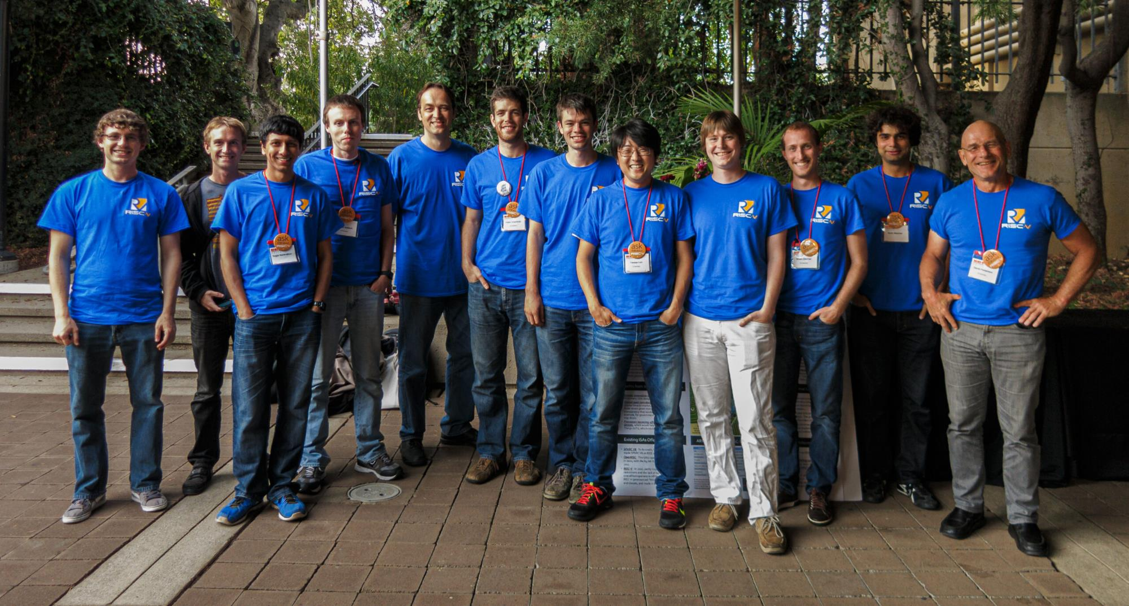
Build RISC-V into your company strategy, and your personal mission
RISC-V is a community of passionate, dedicated, and invested stakeholders
As individuals
As companies
As universities
As public institutions and non-profits
As nations
As one Global, connected movement

Slide 20
“The future of American industry depends on open source tech, … RISC-V is gaining traction in the hardware manufacturing space throughout the world, because it lowers barriers to entry and increases chip development speed.” -- Wired
“Though the architecture was created a decade ago by university professors, RISC-V has been building its ecosystem for years and has started to hit its stride with big licensees like Western Digital, SiFive, and even NVIDIA itself.”
-- VentureBeat
“If it succeeds, RISC-V could lower the cost of developing a new chip and help companies of all sizes to build exactly the processors they need.”
-- Engadget
Notes:
Wired published an article about how “the future of American industry depends on open source tech,” and highlighted how “RISC-V is gaining traction in the hardware manufacturing space throughout the world, because it lowers barriers to entry and increases chip development speed.”
VentureBeat discussed the momentum of RISC-V writing, “Though the architecture was created a decade ago by university professors, RISC-V has been building its ecosystem for years and has started to hit its stride with big licensees like Western Digital, SiFive, and even Nvidia itself.”
Engadget published a 14 minute video discussing RISC-V, and noted that “if it succeeds, RISC-V could lower the cost of developing a new chip and help companies of all sizes to build exactly the processors they need.”

Slide 21
Thank you
www.riscv.org
@risc_v
@Calista_Redmond
risc-v-international calistaredmond

Slide 22
Membership options
Premier Member Benefits
Community level benefits plus…
Board seat and Technical Steering Committee seat included for $250k level
Technical Steering Committee seat included for $100k level
Summit speaker session
Solution provider listing
2 blogs per month
2 social media spotlights per month
Spotlight member profile
Inclusion in event promotions
Strategic Member Benefits
Community level benefits plus…
Use of RISC-V Trademark for commercialization
3 Board reps elected for tier, includes Premier members that do not otherwise have a board seat.
Eligible to lead workgroup and/or committee
Solution provider listing
1 blog per month
1 social media spotlight per month
Community Member Benefits
Accelerated development, reduced risk through open source, ratified ISA.
Eligible to participate in workgroups, influence strategy and adoption
6 support programs in Technical Deliverables, Compliance, Visibility, Learning, Advocacy, and Marketplace
1 voting Academic Board rep, 1 non-voting Community Board rep
Member logo / name listing in website
Event registration discount
Premier Requirements
Membership open to any type of legal entity, not open to individual members
$250k Annual membership fee that includes Board seat and TSC seat
$100k Annual membership fee that includes TSC seat
Strategic Member Requirements
Membership open to any type of legal entity, not open to individual members
Annual membership fee based on employee size
5,000+ employees $35k
500-5,000 employees $15k
<500 employees $5k
Community Requirements
Membership open to academic institutions, non-profits, and individuals not representing a legal entity
No annual membership fee

Slide 23
Technical Groups
Board of Directors (BOD)
Technical Steering Committee (TSC)
Chairs
Security Subcommittee
Crypto TG
Profiles & Platform Subcommittee
Linux class OSs
RTOSs
DMA
Multi-processing
Hypervisors
JITs
Overlays
IOMMU, Buses
Bootloaders
Distro coord/build/rel
*BIs
B (bitmanip) TG
Security Response TG
J (jit) TG
Functional Safety
E2E Data Integrity
Diagnosability
Recoverability
PCIe error reporting
Data poisoning containment
Error recording
Error reporting
Error isolation
P (packed dec) TG
Zfinx TG
RASD (Recoverability, Availability, Serviceability Dependability) TS
V (vector) TG
Unprivileged SC
Alt FP Formats TG
IMAFDCQ extensions
Memory Model
Profiles
MCU profile
Opcodes
L extension
Testing Subcommittee
Software Standing Committee
Config TG
ISA Infrastructure Subcommittee
Architecture tests TG
Cache Mgmt (CMO) TG
Horizontals (Attributes) Standing Committee
Tool Chain & Runtimes Subcommittee
EABI TG
Libraries
Benchmarks
Hypervisor TG
Simulators TG
Virtual Memory TG
Documentation
Code Speed SIG
Privileged SC
Fast Interrupts TG
Formal Model TG
HPC SIG
Libraries
Benchmarks
AI/ML/NLP TG
Trusted Exec (TEE) TG
SOC Infrastructure Subcommittee
Debug revision TG
DB/App TG
Frameworks (Spark, Hadoop, etc.)
Benchmarks
interrupts
Trace TG
Managed Runtime TG
Privileged Spec 1.11
Nexus TG
Native code
GCC
LLVM
Optimizer
Profiler
gdb
Virtual machines
Interpreters
JITs
Automotive
Consumer
Datacenter
Energy
Finance
Communications
Defense
Performance Subcommittee
Functional Safety SIG
Verticals SC
Code Size Reduction TS
Embedded Subcommittee
Toolchain improvements
Further extensions
SC: Standing Committee
TS: Technical Subcommittee
TG: Task Group SIG: Special Interest
Proposed
Completed
Area of Responsibility

