Slide 1
RISC-V: The Open Era of Computing
Calista Redmond
CEO, RISC-V International

Slide 2
Our world is shaped
When the playing field is weighted by the interests of only a few, it’s time for the game to change
through positive inventions and negative disruptions
through advances in technology and new business models
through economic and political setbacks

Slide 3
Reshaping history is about removing barriers, coming together, and taking a united approach

Slide 4
Welcome to the open era of computing.
RISC-V is the free and open Instruction Set Architecture…
Driven through open collaboration
Enabling freedom of design across all domains and industries
Cementing the strategic foundation of semiconductors

Slide 5
Disruptive Technology
Barriers | Legacy ISA | RISC-V ISA
Complexity | 1500+ base instructions Incremental ISA | 47 base instructions Modular ISA
Design freedom | $$$ – Limited | Free – Unlimited
License and Royalty fees | $$$ | Free
Design ecosystem | Moderate | Growing rapidly. Numerous extensions, open and proprietary cores
Software ecosystem | Extensive | Growing rapidly
Notes:
The increasing complexity of legacy microprocessors has become profound, requiring hundreds of engineers, millions in investment, and months and years in development.
RISC-V is the ISA of our time and the open foundation for our collective future.
The flexibility and innovation potential across performance, power, size, implementation, core design, and other unique variables are infinitely possible.
Infinite because you no longer need an army of experts for each element.
In RISC-V, complexity is managed through extensions and IP blocks, the composition becoming the unique innovation rather than the individual blocks.
Fun fact! With 47 instructions in the base ISA, RISC-V is the smallest ISA for 32- bit and 64 bit addresses. By comparison, another popular architecture has more than 1500 instructions.
This has tangible impact, in RISC-V we’re composing designs that leverage only the necessary extensions.
This modular and reduced code approach also has positive impacts for power consumption.
RISC-V is fundamentally designed for unique designs, it is the innovation platform for the things that shape our lives and the world around us.
RISC-V adoption is in motion across industries such as AI, IoT, security, HPC, AR/VR, automotive, embedded, industrial, and more.
We’re progressing on a continuum, working up from the ISA and core IP to build a greater ecosystem from packaging to boards to software

Slide 6
Industry innovation on RISC-V
Hardware
– RV64, multi-heart CPUs, vectors, bit manipulation, hypervisors, debug mode –
AI SoCs
Application processors
Software
Linux
Drivers
AI Compilers
Hardware
– RV32, privilege modes, interrupts –
IoT SoCs
Microcontrollers
Software
RTOS
Firmware
Hardware
– RV32 –
Proof of Concept SoCs
Minion processors for power management, communications, …
Software
Bare metal software
Hardware
ISA Definition
Test Chips
Software
Tests
Complexity
2010 – 2016
2017 – 2018
2019 – 2020
2021

Slide 7
Unconstrained Opportunity
RISC-V Business Model
Barriers removed
Design risk
Cost of entry
Partner limitations
Supply chain
Collaboration partners
Development
Supply chain
Expanded markets
Expanded
geographies
Notes:
Business barriers to entry in the microprocessor industry have been enormous – hundreds of millions of dollars and hundreds of people working for years.
For decades we’ve relied on the economics of reducing the cost per transistor and wafer density toward increasing volumes to recoup investment.
Given the cost of entry, our industry was limited to few companies that could afford to be in the game.
That didn’t leave us with much to pick from and once we did, switching costs were high and we were locked in.
RISC-V has disrupted the entire business and technical status quo
Unconstrained opportunity means open:
Collaboration partners
Suppliers
Adjacent markets
Geographies
Open Source and global standards have taken substantial risk, investment, time, and constraints out of custom processor design.
When multiple stakeholders are invested across numerous domains, geographies, and implementations, you reduce the uncertainty of strategically choosing to build on RISC-V.
You have an invested global community
No one entity, person, or geography owns the technology. We all do.
This creates a cycle of growth
The building blocks we all rely on are in the public domain.
Multiple stakeholders continue to invest in RISC-V and grow the ecosystem,
The collective effect is building confidence and strategic investment in RISC-V.

Slide 8
Beyond removing barriers, RISC-V fuels our community to seize growing opportunities

Slide 9
By 2025, 40% of application-specific integrated circuits (ASICs) will be designed by OEMs, up from around 30% today. Custom ICs Based on RISC-V Will Enable Cost-Effective IoT Product Differentiation Gartner, June 2020
Source: Gartner
Notes:
https://www.gartner.com/en/documents/3986115/report-highlight-for-market-trends-custom-ics-based-on-r

Slide 10
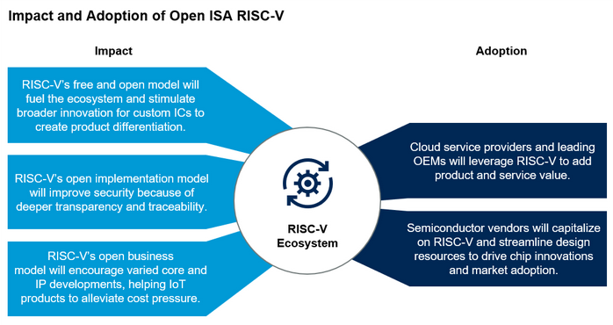
RISC-V’s open model will spur adoption by cloud service providers and streamline resources for chip vendors
Source: Gartner ID: 46523_C
Notes:
https://www.gartner.com/document/3981573?ref=solrAll&refval=264798788

Slide 11
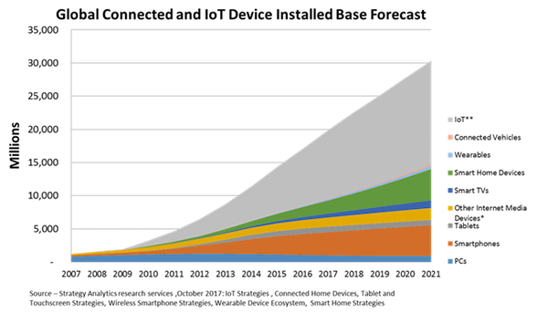
30 billion connected and IoT devices demand security and custom processors
Source: Strategy Analytics

Slide 12
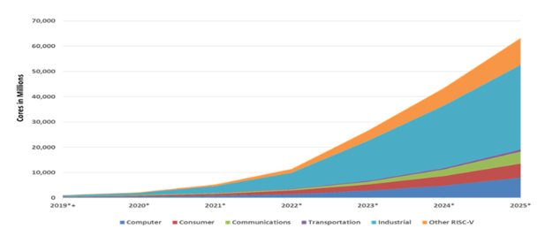
Rapid RISC-V growth led by industrial
62.4 billion RISC-V CPU cores by 2025
Semico Research predicts the market will consume 62.4 billion RISC-V CPU cores by 2025, a 146.2% CAGR 2018-2025. The industrial sector to lead with 16.7 billion cores.
Source: Semico Research Corp
Notes:
"Companies are turning to RISC-V solutions for a wide variety of applications and to address a wide range of performance and volume requirements," says Semico president Jim Feldhan.

Slide 13
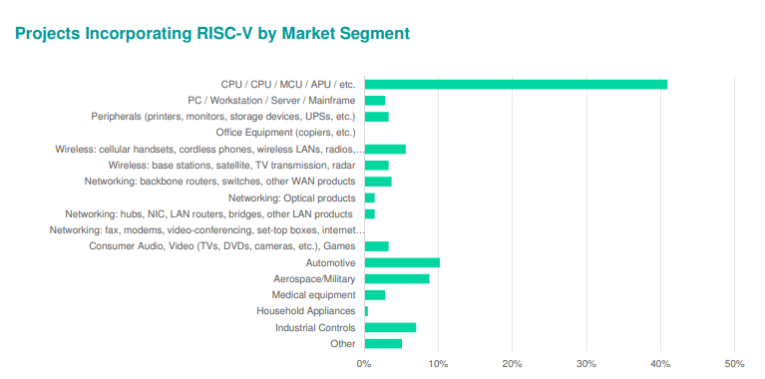
Nearly a quarter of designs incorporate RISC-V
Wilson Research Group/Siemens found that 23% of ASIC and FPGA projects incorporated RISC-V in at least one processor in a double-blind 2020 study.
Notes:
https://www.techdesignforums.com/blog/2020/11/27/risc-v-in-nearly-a-quarter-of-designs-wilson-functional-verification-2020-part-one/?mc_cid=4598aad76e&mc_eid=579aaa7d6f

Slide 14
RISC-V IP, SW, and Tools build momentum
The total market for RISC-V IP and Software is expected to grow to $1.07 billion by 2025 at a CAGR of 54.1%
Source: Tractica
Notes:
https://riscv.org/wp-content/uploads/2019/12/12.11-14.20a9-Joshi-Tractica-Processor-IP-Showcase-with-Andes-Technology-CHIPS-Alliance-Codasip-Shakti-Project-SiFive-Syntacore-OpenHW-Group-1.pdf
https://tractica.omdia.com/research/risc-v-processors/

Slide 15
RISC-V adoption spans industries and workloads
Cloud and data center top providers like Amazon and Alibaba are designing their own chips.
Mobile and wireless continue rapid evolution with each generation of hardware and increased capability.
Automotive is transforming from autonomous vehicles to infotainment to safety, the whole vehicle relies on innovative electronics.
Consumer and IoT devices bring incredible innovation and volume with billions of connected devices in the next 5-10 years.
Industrial IoT incorporating artificial intelligence in manufacturing and industrial processes.
Memory was largest semiconductor category by sales with $158 billion in 2018, and the fastest-growing.
Notes:
The RISC-V community is already making an impact across industries.
In automotive, we’ve seen progress in safety and security from NVIDIA and have worked with them to form the Functional Safety Special Interest Group in RISC-V
In HPC, we continue to work with the European Commission on RISC-V acceleration for super computers through the EPI initiative as well as sharing insights on open source approaches to technology to reduce risk and dependency on any one entity.
The future for RISC-V is incredibly bright in areas with legacy architectures as well as new arenas with growing adoption of custom processors.
In the memory semiconductor space, growth projections range from 6-16% on this $100Billion market led by Flash, Telecomm, and Consumer electronics.
Industrial and Automotive are close behind as we bring more compute and memory solutions to safety, automated driving, infotainment and more.
IOT continues to be hot growth area. IoT devices are includes a broad range of electronics, household appliances, automotive, and commercial IoT for manufacturing, logistics and transportation. Business insider forecasts more than 64 billion IoT devices by 2026, driving a $15 trillion market.
Predictions from Semico predict RISC-V cores to climb to 62.4 billion by 2025 across industrial, transportation, communications, consumer and other compute implementations.
We’re continuing to collaborate not only within our community, but externally across entities such as Global Platform for security standards as well as 15 other alliances including alliances for research, education, industry adoption, software support, and regional RISC-V groups.

Slide 16
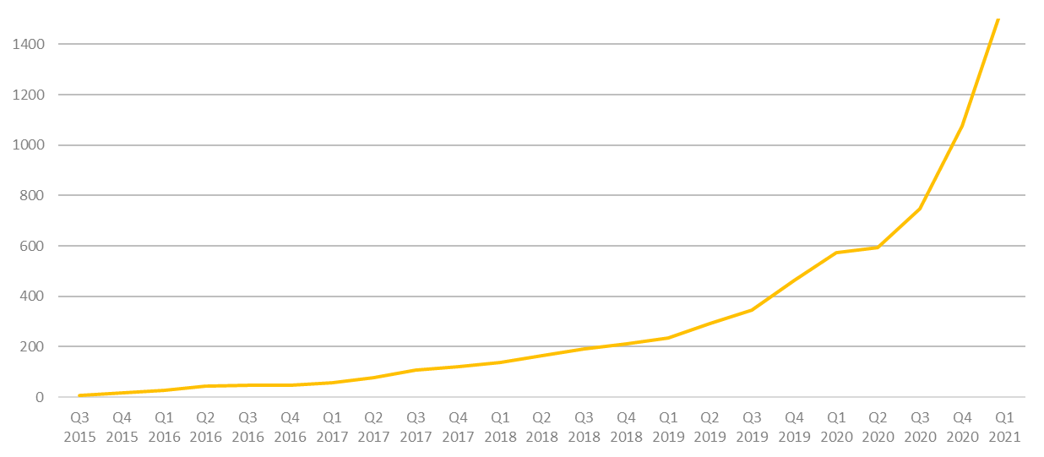
More than 1,500 RISC-V Members
across 70 Countries
94 Chip SoC, IP, FPGA
4 I/O Memory, network, storage
12 Services Fab, design services
40 Software Dev tools, firmware, OS
4 Systems ODM, OEM
13 Industry Cloud, mobile, HPC, ML, automotive
81 Research Universities, Labs, other alliances
1,000+ Individuals
RISC-V engineers and advocates
In 2020, RISC-V membership grew 133%
March 2021

Slide 17
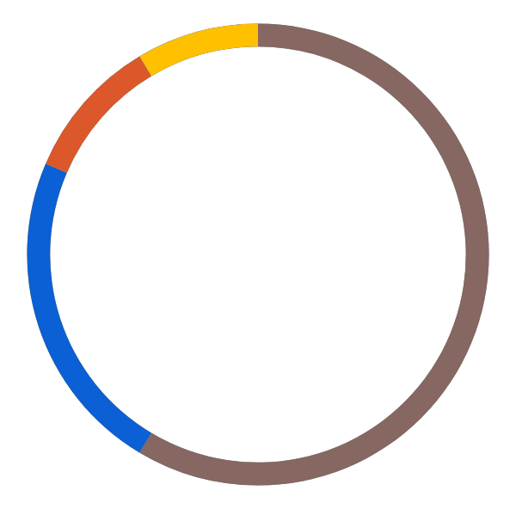
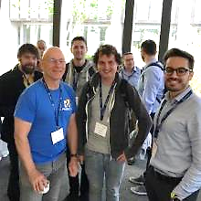
Dedicated Community
Services Fab, design services
Chip SoC, IP, FPGA
I/O Memory, network, storage
Universities and Research
Software Dev tools, firmware, OS
Industry cloud, mobile, HPC, ML, automotive
Press and Analysts
Investors and Funding sources
Individual Advocates
Notes:
Our community is incredible.
Today we have more than 690 members spanning 50 countries. Our global community is distributed about 1/3 in North America, 1/3 in Europe, and 1/3 in APAC.
RISC-V has seen tremendous engagement and collaboration across our 37 technical and industry committees and workgroups.
Our dedicated community is driving progress.
We’re gaining momentum in open technical deliverables,
our members are growing their commercial success,
entrepreneurs are starting new companies,
investors are funding RISC-V companies,
multi-nationals are building beyond microcontrollers,
public institutions are specifying RISC-V,
Students and professors are integrating RISC-V in research and studies
We’re rapidly cultivating an ecosystem of stakeholders across all dimensions

Slide 18
Incredible industry progress
The European Processor Initiative finalized the first version of its RISC-V accelerator architecture and will deliver test chip in 2021.
The RIOS Lab announced PicoRio, an affordable RISC-V open source small-board computer available in 2021.
Imperas announced first RISC-V verification reference model with UVM encapsulation.
Seagate announced hard disk drive controller with high-performance RISC-V CPU.
GreenWaves ultra-low power GAP9 hearables platform enabling scene-aware and neural network-based noise reduction.
Alibaba unveiled RV64GCV core in its Xuantie 910 processor for cloud and edge servers.
Microchip released the first SoC FPGA development kit based on the RISC-V ISA.
Andes released superscalar multicore and L2 cache controller processors.
StarFive released the world’s first RISC-V AI visual processing platform
SiFive unveiled world’s fastest development board for RISC-V Personal Computers.
Micro Magic announced an incredibly fast 64-bit RISC-V core achieving 5GHz and 13,000 CoreMarks at 1.1V.
Notes:
The European Processor Initiative partners have finalized the first version of its RISC-V accelerator architecture, named EPAC, and are working towards the delivery of the first EPAC Test Chip in 2021. Link
The RISC-V International Open Source Laboratory (also known as RIOS Lab), announced the PicoRio open-source project. The PicoRio will be a RISC-V-based small-board computer available at an affordable price point, and will be available to ship in the first half of 2021. Link
Imperas announced the first reference model with UVM encapsulation for RISC-V verification.
Micro Magic announced the world’s fastest 64-bit RISC-V core achieving 5GHz and 13,000 CoreMarks at 1.1V.
Microchip released the industry’s first SoC FPGA development kit based on the RISC-V ISA.
Saifang Technology released the world’s first RISC-V AI visual processing platform-Jinghong 7100.
SiFive unveiled the world’s fastest RISC-V development board. The board is available for $665.

Slide 19
RISC-V is the foundation of the open era of computing
3,000+ individuals in 60+ RISC-V work groups and committees
312 RISC-V solutions online including cores, SoCs, software, tools and developer boards.
31 local RISC-V community groups, with more than 5,700 engineers
We’re in the news! We have 34k+ followers on social media and so far this year, we have participated in 150+ news articles along with amplifying RISC-V community news.
Notes:
RISC-V membership has grown by 50%, continuing the trajectory since we formed 5 years ago
Across our membership, more than 2,000 individuals are engaged in 37 RISC-V work groups and committees, this is nearly double the RISC-V groups and a 40% increase in engagement
We’ve seen participation grow by 63% in our 23 local meetup and event groups around the world
We’re getting a lot of attention! We’ve added more than 5,000 followers on social media and have participated in more than 80 news articles along with amplifying the RISC-V news of our community more than 300 times.

Slide 20
Engaging the community in work that matters
We are defining Profiles to standardize a set of instructions and state.
If an implementer then they should be able to run the same instructions on multiple implementations and get the same results.
The initial Profiles are RVA20 and RVM20 for extensions ratified in 2019 and RVA22 and RVM22 for extensions ratified in 2021 including vector, crypto scalar, and bit manipulation.
We are defining Platforms to be a standard set of features for a complete execution environment (like Linux or FreeRTOS).
If you adhere to a Platform then you should be able to run the same executable on 2 different platforms and get the same results (excluding timing differences, etc.)
Platforms will include things like Profiles, Device tree, ABIs, etc.
2021 holds an exciting set of new extensions for vector processing, cryptography, bit manipulation, packed decimal, trusted execution environment, virtual memory, and more enabling sectors and industries from embedded to ML to HPC and everything in between.
In addition, we are revamping our documentation with a new look, fully adopting AsciiDoc, enhancing the specifications with glossaries and indexes, and common formal diagram insertion.
We have a number of programs underway
RISC-V Development Partners - institutions (CAS, RIOS, IITM) help develop ecosystem software for extensions
RISC-V Labs - institutions build labs with RISC-V based board and servers to both run regression testing and to provide the community with an area to sandbox
RISC-V Seed program - seed 1000 boards to academia and early adopters by June 2022
Joint working group on Coherence between Chips Alliance and RISC-V

Slide 21
RISC-V delivers incredible member support
Technical Deliverables
Guard against fragmentation
Build technical deliverables
Work groups
Compliance + Verification
Testing and compliance suites
Compliance tests
Visibility
Constant drumbeat through press, media, and original content
Industry and regional events
Dedicated RISC-V events
Learning + Talent
Multi-level online learning
Connecting universities with labs, tests, and curricula
RISC-V Training Partners
Advocacy
Technical advocate program
Local developer groups and events
RISC-V Ambassadors
Geo and industry alliances
Marketplace Exchange
Online marketplace of providers, products, and services
Technical developer forums

Slide 22
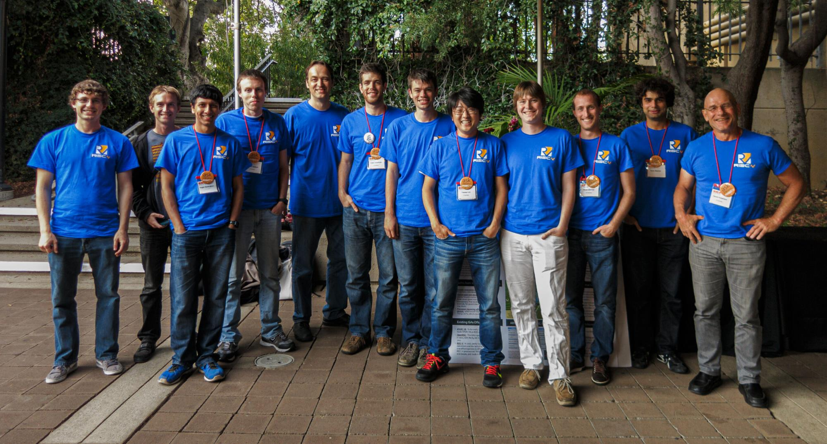
Build RISC-V into your company strategy, and your personal mission
RISC-V is a community of passionate, dedicated, and invested stakeholders
As individuals
As companies
As universities
As public institutions and non-profits
As nations
As one Global, connected movement

Slide 23
“The future of American industry depends on open source tech, … RISC-V is gaining traction in the hardware manufacturing space throughout the world, because it lowers barriers to entry and increases chip development speed.” -- Wired
“Though the architecture was created a decade ago by university professors, RISC-V has been building its ecosystem for years and has started to hit its stride with big licensees like Western Digital, SiFive, and even NVIDIA itself.”
-- VentureBeat
“If it succeeds, RISC-V could lower the cost of developing a new chip and help companies of all sizes to build exactly the processors they need.”
-- Engadget
Notes:
Wired published an article about how “the future of American industry depends on open source tech,” and highlighted how “RISC-V is gaining traction in the hardware manufacturing space throughout the world, because it lowers barriers to entry and increases chip development speed.”
VentureBeat discussed the momentum of RISC-V writing, “Though the architecture was created a decade ago by university professors, RISC-V has been building its ecosystem for years and has started to hit its stride with big licensees like Western Digital, SiFive, and even Nvidia itself.”
Engadget published a 14 minute video discussing RISC-V, and noted that “if it succeeds, RISC-V could lower the cost of developing a new chip and help companies of all sizes to build exactly the processors they need.”

Slide 24
Thank you
www.riscv.org
@risc_v
@Calista_Redmond
risc-v-international calistaredmond

Slide 25
Benefit of joining RISC-V
Accelerate technical traction and insight
Contribute technical priorities, approaches, and code
Gain strategic and technical advantage
Increase visibility, leadership, and market insight
Fill and increase engineering skills, retain and attract talent
Build innovation partner network and customer pipeline
Deepen, engage, and lead in local and industry developer network
Showcase RISC-V products, services, training, and resources

Slide 26
Membership options
Premier Member Benefits
Community level benefits plus…
Use of RISC-V Trademark for commercialization
Board seat and Technical Steering Committee seat included for $250k level
Technical Steering Committee seat included for $100k level
Solution listing on RISC-V Exchange
4 case studies a year, 2 blogs per month
2 social media spotlights per month
Spotlight member profile
Inclusion in event promotions
Strategic Member Benefits
Community level benefits plus…
Use of RISC-V Trademark for commercialization
3 Board reps elected for tier, includes Premier members that do not otherwise have a board seat.
May lead workgroup and/or committee
Solution listing on RISC-V Exchange
1 case study a year, 1 blog per month
1 social media spotlight per month
Community Member Benefits
Accelerated development, reduced risk through open source, ratified ISA.
May participate in workgroups, influence strategy and adoption
6 support programs in Technical Deliverables, Compliance, Visibility, Learning, Advocacy, and Marketplace
1 voting Academic Board rep,
1 non-voting Community Board rep
Member listing on RISC-V website
Event registration discount
Premier Member Requirements
Membership open to any type of legal entity, not open to individual members
$250k Annual membership includes Board seat and Technical Steering Committee seat
$100k Annual membership includes TSC seat
Strategic Member Requirements
Membership open to any type of legal entity, not open to individual members
Annual membership based on employee size
$35k for 5,000+ employees
$15k for 500-5,000 employees
$5k for <500 employees
$2.5k for <10 employees / company <2 years old
Community Member Requirements
Membership open to academic institutions, non-profits, and individuals not representing a legal entity
No annual membership fee

Slide 27
Technical Groups
Board of Directors (BOD)
Technical Steering Committee (TSC)
Chairs
Security Subcommittee
Crypto TG
Profiles & Platform Subcommittee
Linux class OSs
RTOSs
DMA
Multi-processing
Hypervisors
JITs
Overlays
IOMMU, Buses
Bootloaders
Distro coord/build/rel
*BIs
B (bitmanip) TG
Security Response TG
J (jit) TG
Functional Safety
E2E Data Integrity
Diagnosability
Recoverability
PCIe error reporting
Data poisoning containment
Error recording
Error reporting
Error isolation
P (packed dec) TG
Zfinx TG
RASD (Recoverability, Availability, Serviceability Dependability) TS
V (vector) TG
Unprivileged SC
Alt FP Formats TG
IMAFDCQ extensions
Memory Model
Profiles
MCU profile
Opcodes
L extension
Testing Subcommittee
Software Standing Committee
Config TG
ISA Infrastructure Subcommittee
Architecture tests TG
Cache Mgmt (CMO) TG
Horizontals (Attributes) Standing Committee
Tool Chain & Runtimes Subcommittee
EABI TG
Libraries
Benchmarks
Hypervisor TG
Simulators TG
Virtual Memory TG
Documentation
Code Speed SIG
Privileged SC
Fast Interrupts TG
Formal Model TG
HPC SIG
Libraries
Benchmarks
AI/ML/NLP TG
Trusted Exec (TEE) TG
SOC Infrastructure Subcommittee
Debug revision TG
DB/App TG
Frameworks (Spark, Hadoop, etc.)
Benchmarks
interrupts
Trace TG
Managed Runtime TG
Privileged Spec 1.11
Nexus TG
Native code
GCC
LLVM
Optimizer
Profiler
gdb
Virtual machines
Interpreters
JITs
Automotive
Consumer
Datacenter
Energy
Finance
Communications
Defense
Performance Subcommittee
Functional Safety SIG
Verticals SC
Code Size Reduction TS
Embedded Subcommittee
Toolchain improvements
Further extensions
SC: Standing Committee
TS: Technical Subcommittee
TG: Task Group SIG: Special Interest
Proposed
Completed
Area of Responsibility

Slide 28
RISC-V launched new programs to support member success
RISC-V Technical Steering Committee to govern technical strategy, build technical leadership and best practice decision-making
RISC-V Learn encompassing university curricula, online learning and Training Partners
RISC-V Ambassadors and Alliances to reach beyond our community for industry collaboration, leadership, and technical engagement.
RISC-V Exchange to showcase RISC-V cores, SoCs, developer boards, software, tools and other resources.

Slide 29
From Embedded to Enterprise
The EU Horizon 2020 De-RISC platform for aerospace has achieved several hardware and software milestones since it began a year ago.
The School of Computing at the Tokyo Institute of Technology developed a portable Linux RISC-V SoC design in just 5,000 lines of Verilog.
Huami released a new RISC-V based AI chip for biometric wearables
CHIPS Alliance announced enhancements to the RISC-V SweRV Core EH2, the world’s first dual-threaded, commercial, embedded RISC-V core and SweRV Core EL2, an ultra-small, ultra-low-power RISC-V core.
Alibaba unveiled its RISC-V RV64GCV core that will be used for its Xuantie 910 processor aimed at cloud and edge servers.
Notes:
De-RISC, the Horizon 2020 project by the European Union that aims to create a market-ready platform based on RISC-V for the aerospace market, has achieved a number of hardware and software milestones since it was started a year ago. Link
A team from the School of Computing at the Tokyo Institute of Technology developed a portable and Linux-capable RISC-V SoC design in just 5,000 lines of Verilog.
CHIPS Alliance announced new enhancements to the RISC-V based SweRV Core EH2 and SweRV Core EL2. The SweRV Core EH2 is the world’s first dual-threaded, commercial, embedded RISC-V core, and SweRV Core EL2 is an ultra-small, ultra-low-power RISC-V core.
Alibaba unveiled its RISC-V RV64GCV core that will be used for its Xuantie 910 processor aimed at cloud and edge servers.
Huami released a new RISC-V based AI chip for biometric wearables.

Slide 30
April 22-23, 2021
9am - 17pm Japan Standard Time
Free Registration Program Slack: risc-v-association.slack.com
SiFive and Andes who are leading RISC-V IP products. DTS-Insight, a descendent of a part of Yokokawa Electric, is presenting their RISC-V system solution capabilities both in hardware and software. Espressif, presents their new RISC-V based WiFi BTLE chip. Synopsis presents RISC-V based AI accelerator. Effinix, an FPGA startup, is presenting their RISC-V solutions in their FPGA product. GigaDevice is presenting their award-winning flash microcontrollers. Syntacore is presenting their open-source and commercial RISC-V solutions. Cloudbear is presenting the use case of their RISC-V processor IP. In the meanwhile, here in Japan, Renesas Electronics Corporation announced the adoption of RISC-V. Japanese researchers and companies are beginning to lead in software and hardware architectural research in RISC-V security. Google is promoting open source EDA tools, open source process development kits (PDK), open source free shuttles. We see corresponding contributors in Japan who are presenting.

