Slide 1
RISC-V Introduction
Welcome to the Open era of computing!

Slide 2
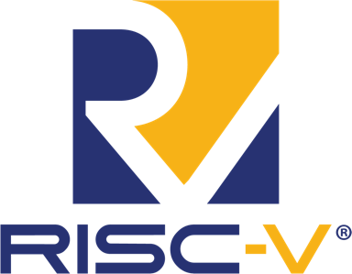
Who is RISC-V
RISC-V International is a global nonprofit association based in Switzerland. Founded in 2015 as the RISC-V Foundation with 29 members, RISC-V is now a truly global organization with 2k+ members in more than 70 countries.
RISC-V supports the free and open RISC instruction set architecture and extensions delivering a new level of free, extensible software and hardware freedom on architecture, paving the way for the next 50 years of computing design and innovation.
RISC-V is part of the Linux Foundation, bringing the community together to build and maintain the open RISC-V ISA.

Slide 3
Welcome to the Open era of computing.
RISC-V is the free and open Instruction Set Architecture…
Driven through open collaboration
Enabling freedom of design across all domains and industries
Cementing the strategic foundation of semiconductors

Slide 4
Disruptive Technology
Barriers
Complexity
Design freedom
License and Royalty fees
Design ecosystem
Software ecosystem
Legacy ISA
1500+ base instructions Incremental ISA
$$$ – Limited
$$$
Moderate
Extensive
RISC-V ISA
47 base instructions Modular ISA
Free – Unlimited
Free
Growing rapidly. Numerous extensions, open & proprietary cores
Growing rapidly
Notes:
The increasing complexity of legacy microprocessors has become profound, requiring hundreds of engineers, millions in investment, and months and years in development.
RISC-V is the ISA of our time and the open foundation for our collective future.
The flexibility and innovation potential across performance, power, size, implementation, core design, and other unique variables are infinitely possible.
Infinite because you no longer need an army of experts for each element.
In RISC-V, complexity is managed through extensions and IP blocks, the composition becoming the unique innovation rather than the individual blocks.
Fun fact! With 47 instructions in the base ISA, RISC-V is the smallest ISA for 32- bit and 64 bit addresses. By comparison, another popular architecture has more than 1500 instructions.
This has tangible impact, in RISC-V we’re composing designs that leverage only the necessary extensions.
This modular and reduced code approach also has positive impacts for power consumption.
RISC-V is fundamentally designed for unique designs, it is the innovation platform for the things that shape our lives and the world around us.
RISC-V adoption is in motion across industries such as AI, IoT, security, HPC, AR/VR, automotive, embedded, industrial, and more.
We’re progressing on a continuum, working up from the ISA and core IP to build a greater ecosystem from packaging to boards to software

Slide 5
Industry innovation on RISC-V
Hardware
– RV64, multi-heart CPUs, vectors, bit manipulation, hypervisors, debug mode –
AI SoCs
Application processors
Software
Linux
Drivers
AI Compilers
Hardware
– RV32, privilege modes, interrupts –
IoT SoCs
Microcontrollers
Software
RTOS
Firmware
Hardware
– RV32 –
Proof of Concept SoCs
Minion processors for power management, communications, …
Software
Bare metal software
Hardware
ISA Definition
Test Chips
Software
Tests
Complexity
2010 – 2016
2017 – 2018
2019 – 2020
2021

Slide 6
RISC-V Innovation Roadmap
RISC-V tech roadmap
AI SoCs, Application processors, Linux Drivers, AI Compilers
Dev Board program
Development Partners
RISC-V Labs, Security response process, AI SIG, Graphics SIG, Android SIG, Communications SIG
Industry Adoption
IoT SoCs
Microcontrollers
RTOS, Firmware
Development tools
Technical Steering Committee, HPC SIG, GlobalPlatform partnership
Proliferation of RISC-V CPUs across performance and application spectrum
RISC-V dominant in universities
Strategic and growing adoption in HPC, automotive, transportation, cloud, industrial, communications, IoT, enterprise, consumer, and other applications
Proof of Concept SoCs
Minion processors for power management, communications
Bare metal software
Test Chips
Software tests
Linux port
2010 – 2016 2017 2018 2019 2020 2021 2022 2023 2024 2025
ISA Definition
RV32
RV32I and RV64I
Base instructions: Integer, floating point, multiply and divide, atomic, and compact instructions
Priv modes, Interrupts, exceptions, memory model, protection, and virtual memory
Arch compatibility framework,
Processor trace
Zfinx
ZiHintPause
BitManip
Vector
RISC-V Profiles & Platforms
Crypto Scalar
Virtual Memory
Hypervisor & Advanced interrupt architecture
Cache mgt ops
Code size reduction*
Trusted Execution Environment*
P (Packed SIMD)*
RV32E and RV64E
64 bit and 128 bit addresses*
Vector Atomic and quad-widening*
Quad floating point in integer registers*
Crypto Vector*
Trusted Execution phase 2*
Jit pointer masking & I/D synch*
BitManip phase 2*
Cache management phase 2*
… and more
RISC-V Foundation
Technical Deliverables
* On track, subject to change

Slide 7
RISC-V Ecosystem
HPC Data Center
Consumer IoT Networking
Applications
Runtimes
SAIL
Operating Systems
SPIKE
Hypervisor
Training
Academia Research
Boot
Services
ISA
CI/Testing
Profilers + Analysis Tools
Simulators
Compilers
Reliable, Serviceable, Diagnostic
Performance
Security
Formal Model
Architecture Tests
Debug
SAIL
RTL
DV
Implementation Design & Microarchitecture
Silicon Soft IP

Slide 8
Unconstrained Opportunity
RISC-V Business Model
Barriers removed
Design risk
Cost of entry
Partner limitations
Supply chain
Collaboration partners
Development
Supply chain
Expanded markets
Expanded
geographies
Notes:
Business barriers to entry in the microprocessor industry have been enormous – hundreds of millions of dollars and hundreds of people working for years.
For decades we’ve relied on the economics of reducing the cost per transistor and wafer density toward increasing volumes to recoup investment.
Given the cost of entry, our industry was limited to few companies that could afford to be in the game.
That didn’t leave us with much to pick from and once we did, switching costs were high and we were locked in.
RISC-V has disrupted the entire business and technical status quo
Unconstrained opportunity means open:
Collaboration partners
Suppliers
Adjacent markets
Geographies
Open Source and global standards have taken substantial risk, investment, time, and constraints out of custom processor design.
When multiple stakeholders are invested across numerous domains, geographies, and implementations, you reduce the uncertainty of strategically choosing to build on RISC-V.
You have an invested global community
No one entity, person, or geography owns the technology. We all do.
This creates a cycle of growth
The building blocks we all rely on are in the public domain.
Multiple stakeholders continue to invest in RISC-V and grow the ecosystem,
The collective effect is building confidence and strategic investment in RISC-V.

Slide 9
Beyond removing barriers, RISC-V fuels our community to seize growing opportunities

Slide 10
By 2025, 40% of application-specific integrated circuits (ASICs) will be designed by OEMs, up from around 30% today. Custom ICs Based on RISC-V Will Enable Cost-Effective IoT Product Differentiation Gartner, June 2020
Source: Gartner
Notes:
https://www.gartner.com/en/documents/3986115/report-highlight-for-market-trends-custom-ics-based-on-r

Slide 11
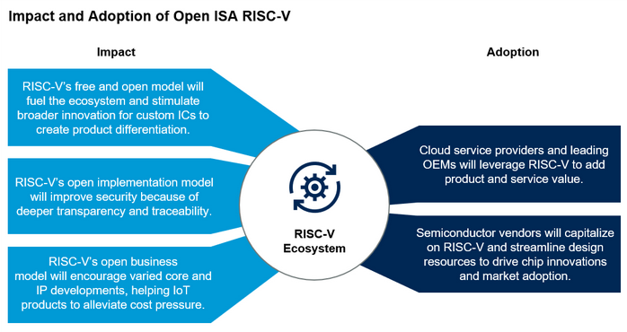
RISC-V’s open model will spur adoption by cloud service providers and streamline resources for chip vendors
Source: Gartner ID: 46523_C
Notes:
https://www.gartner.com/document/3981573?ref=solrAll&refval=264798788

Slide 12
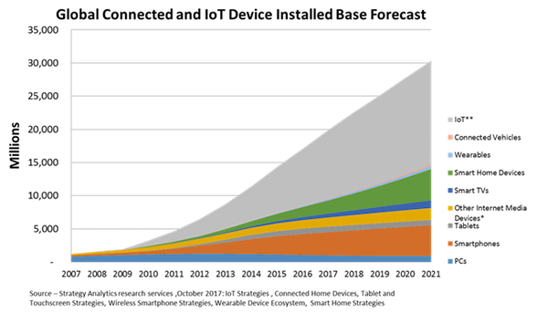
30 billion connected and IoT devices demand security and custom processors
Source: Strategy Analytics

Slide 13
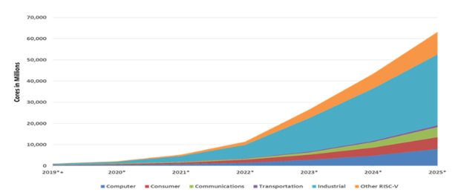
Rapid RISC-V growth led by industrial
62.4 billion RISC-V CPU cores by 2025
Semico Research predicts the market will consume 62.4 billion RISC-V CPU cores by 2025, a 146.2% CAGR 2018-2025. The industrial sector to lead with 16.7 billion cores.
Source: Semico Research Corp
Notes:
"Companies are turning to RISC-V solutions for a wide variety of applications and to address a wide range of performance and volume requirements," says Semico president Jim Feldhan.

Slide 14
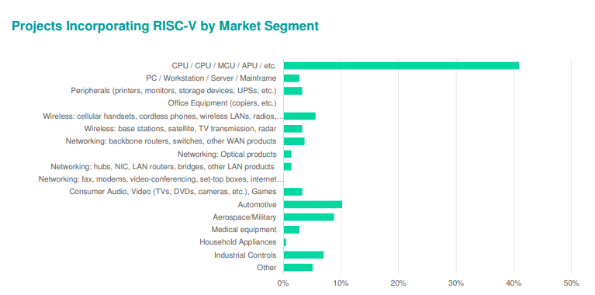
Nearly a quarter of designs incorporate RISC-V
Wilson Research Group/Siemens found that 23% of ASIC and FPGA projects incorporated RISC-V in at least one processor in a double-blind 2020 study.
Notes:
https://www.techdesignforums.com/blog/2020/11/27/risc-v-in-nearly-a-quarter-of-designs-wilson-functional-verification-2020-part-one/?mc_cid=4598aad76e&mc_eid=579aaa7d6f

Slide 15
RISC-V IP, SW, and Tools build momentum
The total market for RISC-V IP and Software is expected to grow to $1.07 billion by 2025 at a CAGR of 54.1%
Source: Tractica
Notes:
https://riscv.org/wp-content/uploads/2019/12/12.11-14.20a9-Joshi-Tractica-Processor-IP-Showcase-with-Andes-Technology-CHIPS-Alliance-Codasip-Shakti-Project-SiFive-Syntacore-OpenHW-Group-1.pdf
https://tractica.omdia.com/research/risc-v-processors/

Slide 16
RISC-V adoption spans industries
Data Center
Cloud, HPC
Top providers like Amazon and Alibaba are designing their own chips.
New features specific to HPC such as Vector and larger Virtual address space
Telecom & Communications
Rapid evolution in 5G, handsets, and base stations grows with each generation of hardware and increased capability
Automotive Transforming from autonomous vehicles to infotainment to safety, the whole vehicle relies on innovative electronics.
Consumer and IoT devices
Incredible innovation is driving volume with billions of connected devices in the next 5-10 years.
AI / ML
Artificial intelligence is incorporated across many areas including Industrial IoT, manufacturing, and financial
Edge Computing
A distributed, open architecture decentralizes processing power, reduces latency, and supports IoT performance in low bandwidth environments.
Notes:
The RISC-V community is already making an impact across industries.
In automotive, we’ve seen progress in safety and security from NVIDIA and have worked with them to form the Functional Safety Special Interest Group in RISC-V
In HPC, we continue to work with the European Commission on RISC-V acceleration for super computers through the EPI initiative as well as sharing insights on open source approaches to technology to reduce risk and dependency on any one entity.
The future for RISC-V is incredibly bright in areas with legacy architectures as well as new arenas with growing adoption of custom processors.
In the memory semiconductor space, growth projections range from 6-16% on this $100Billion market led by Flash, Telecomm, and Consumer electronics.
Industrial and Automotive are close behind as we bring more compute and memory solutions to safety, automated driving, infotainment and more.
IOT continues to be hot growth area. IoT devices are includes a broad range of electronics, household appliances, automotive, and commercial IoT for manufacturing, logistics and transportation. Business insider forecasts more than 64 billion IoT devices by 2026, driving a $15 trillion market.
Predictions from Semico predict RISC-V cores to climb to 62.4 billion by 2025 across industrial, transportation, communications, consumer and other compute implementations.
We’re continuing to collaborate not only within our community, but externally across entities such as Global Platform for security standards as well as 15 other alliances including alliances for research, education, industry adoption, software support, and regional RISC-V groups.
Additional fast growth areas:
Industrial IoT incorporating artificial intelligence in manufacturing and industrial processes.
Memory was largest semiconductor category by sales with $158 billion in 2018, and the fastest-growing.

Slide 17
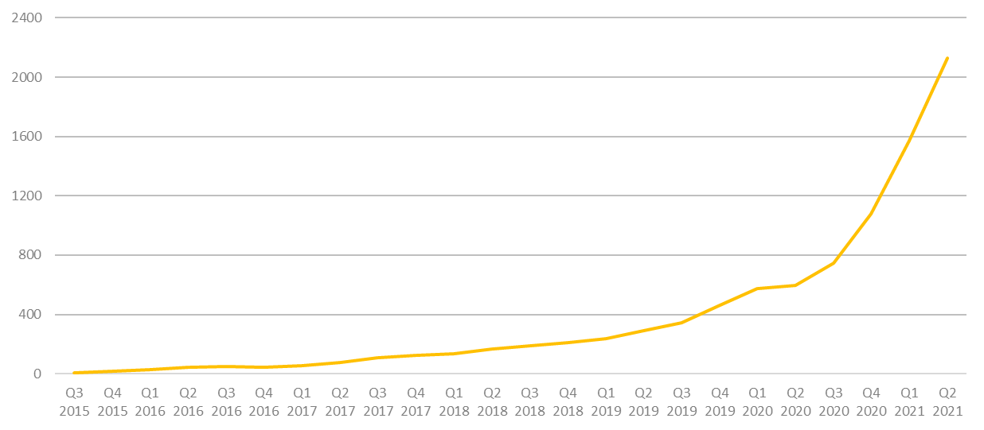
More than 2,200 RISC-V Members
across 70 Countries
102 Chip
SoC, IP, FPGA
4 I/O
Memory, network, storage
17 Services
Fab, design services
42 Software
Dev tools, firmware, OS
4 Systems ODM, OEM
13 Industry Cloud, mobile, HPC, ML, automotive
95 Research Universities, Labs, other alliances
1,900+ Individuals
RISC-V engineers and advocates
RISC-V membership grew 133% in 2020.
In 2021, RISC-V membership has already doubled.
17
June 2021

Slide 18
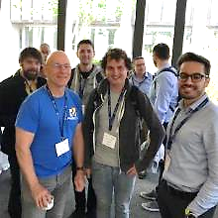
Dedicated Community
Services Fab, design services
Chip SoC, IP, FPGA
I/O Memory, network, storage
Universities and Research
Software Dev tools, firmware, OS
Industry cloud, mobile, HPC, ML, automotive
Press and Analysts
Investors and Funding sources
Individual Advocates
Notes:
Our community is incredible.
Today we have more than 690 members spanning 50 countries. Our global community is distributed about 1/3 in North America, 1/3 in Europe, and 1/3 in APAC.
RISC-V has seen tremendous engagement and collaboration across our 37 technical and industry committees and workgroups.
Our dedicated community is driving progress.
We’re gaining momentum in open technical deliverables,
our members are growing their commercial success,
entrepreneurs are starting new companies,
investors are funding RISC-V companies,
multi-nationals are building beyond microcontrollers,
public institutions are specifying RISC-V,
Students and professors are integrating RISC-V in research and studies
We’re rapidly cultivating an ecosystem of stakeholders across all dimensions

Slide 19
Incredible industry progress
The European Processor Initiative finalized the first version of its RISC-V accelerator architecture and will deliver test chip in 2021.
The RIOS Lab announced PicoRio, an affordable RISC-V open source small-board computer available in 2021.
Imperas announced first RISC-V verification reference model with UVM encapsulation.
Seagate announced hard disk drive controller with high-performance RISC-V CPU.
GreenWaves ultra-low power GAP9 hearables platform enabling scene-aware and neural network-based noise reduction.
Alibaba unveiled RV64GCV core in its Xuantie 910 processor for cloud and edge servers.
Microchip released the first SoC FPGA development kit based on the RISC-V ISA.
Andes released superscalar multicore and L2 cache controller processors.
StarFive released the world’s first RISC-V AI visual processing platform
SiFive unveiled world’s fastest development board for RISC-V Personal Computers.
Micro Magic announced an incredibly fast 64-bit RISC-V core achieving 5GHz and 13,000 CoreMarks at 1.1V.
Notes:
The European Processor Initiative partners have finalized the first version of its RISC-V accelerator architecture, named EPAC, and are working towards the delivery of the first EPAC Test Chip in 2021. Link
The RISC-V International Open Source Laboratory (also known as RIOS Lab), announced the PicoRio open-source project. The PicoRio will be a RISC-V-based small-board computer available at an affordable price point, and will be available to ship in the first half of 2021. Link
Imperas announced the first reference model with UVM encapsulation for RISC-V verification.
Micro Magic announced the world’s fastest 64-bit RISC-V core achieving 5GHz and 13,000 CoreMarks at 1.1V.
Microchip released the industry’s first SoC FPGA development kit based on the RISC-V ISA.
Saifang Technology released the world’s first RISC-V AI visual processing platform-Jinghong 7100.
SiFive unveiled the world’s fastest RISC-V development board. The board is available for $665.

Slide 20
RISC-V is the foundation of the Open era of computing
4k+ individuals in 60+ RISC-V work groups and committees
330+ RISC-V solutions online including cores, SoCs, software, tools, and developer boards
29 local RISC-V community groups, with more than 5,400 engineers
We’re in the news! We have 40k+ followers on social media and across the last year, we have participated in 135+ news articles along with amplifying RISC-V community news 450+ times.
Notes:
RISC-V membership has grown by 50%, continuing the trajectory since we formed 5 years ago
Across our membership, more than 2,000 individuals are engaged in 37 RISC-V work groups and committees, this is nearly double the RISC-V groups and a 40% increase in engagement
We’ve seen participation grow by 63% in our 23 local meetup and event groups around the world
We’re getting a lot of attention! We’ve added more than 5,000 followers on social media and have participated in more than 80 news articles along with amplifying the RISC-V news of our community more than 300 times.

Slide 21
Technical Deliverables
Technical governance
Build technical deliverables
Work groups
Compatibility & Verification
Testing and compatibility resources
Compatibility tests
Visibility
Amplify member news, content, and success with press and analysts
Original content programs
RISC-V, industry, and regional events
Learning & Talent
Multi-level online learning
Connecting universities with labs, tests, and curricula
RISC-V Training Partners
Advocacy + Alliances
RISC-V Ambassadors
Geo and industry alliances
Local developer groups and events
Marketplace Exchange
Online marketplace of providers, products, services, and learn
Technical developer forums
RISC-V delivers incredible member support

Slide 22
RISC-V Technical Programs
RISC-V Platform
A common, reusable runtime environment that operating systems and applications can target to improve portability and reuse. Provides interoperability assurance.
RISC-V Developer Boards
Available to spur innovation, provide hands-on education, and engage early adopters to test and develop.
RISC-V Development Partner
Recognizes the investment and dedication of organizations making significant technical contributions to RISC-V.
RISC-V Lab
Institutions that host a lab with RISC-V hardware for CI/testing and general availability sandboxing.
RISC-V Compatible
Architectural Tests created to help ensure that software written will run on implementations that comply with that profile. Branding available for compatibility.
RISC-V Profiles
Refers to a base ISA and one or more extensions that are specified as a group so that applications can be compiled once, run on different implementations, and get the same results.
Notes:
We have a number of engagement programs underway
RISC-V Development Partners - institutions (CAS, RIOS, IITM) help develop ecosystem software for extensions
RISC-V Labs - institutions build labs with RISC-V based board and servers to both run regression testing and to provide the community with an area to sandbox
RISC-V Developer board program - seed 1000 boards to academia and early adopters by June 2022
Joint working group on Coherence between Chips Alliance and RISC-V as well as a standing security group together with GlobalPlatform.
Profiles. standard set of instructions and state
An implementer should be able to run the same instructions on multiple implementations and get the same results.
Platforms. standard set of features for an execution environment (ie Linux or Zephyr)
If you adhere to a Platform then you should be able to run the same executable on 2 different platforms and get the same results (excluding timing differences, etc.)
Platforms include things Profiles, Device tree, ABIs, etc.
Extensions for 2021. vector processing, cryptography, bit manipulation, packed decimal, trusted execution environment, and virtual memory.
We are revamping documentation, fully adopting AsciiDoc, enhancing the specifications with glossaries and indexes, and common formal diagram insertion.

Slide 23
Profiles and Platforms
ISA Profiles
A set of extensions that are compatible
Extension types: required, optional, unsupported, or incompatible
Two profile types:
Application (RVAyy): Linux-class and other embedded designs with more sophisticated ISA needs
Microcontroller (RVMyy): Cost-sensitive application-optimized embedded designs running bare-metal or simple RTOS environments
Running the same sequence of instruction between implementations are RISC-V compatible
System Platforms
A set of features that are compatible
Includes ISA Profiles, software and hardware system components, standardized hardware/software interfaces, etc
Two Platform types: OS/A and M (naming TBD)
Ability to move an executable from one implementation to another and get the same results are RISC-V Compatible
Notes:
ISA Profiles: Released once a year. “Yy” is for the last 2 digits of the year.
System Platforms: Platforms released once every 2 years; updates and new extensions during the 2-year time frame

Slide 24
Engaging RISC-V community in technical work that matters
RISC-V tech roadmap
Profiles. standard set of instructions and state
An implementer should be able to run the same instructions on multiple implementations and get the same results.
Platforms. standard set of features for an execution environment (ie Linux or Zephyr)
If you adhere to a Platform then you should be able to run the same executable on 2 different platforms and get the same results (excluding timing differences, etc.)
Platforms include things Profiles, Device tree, ABIs, etc.
Extensions for 2021. vector processing, cryptography, bit manipulation, packed decimal, trusted execution environment, and virtual memory.
We are revamping documentation, fully adopting AsciiDoc, enhancing the specifications with glossaries and indexes, and common formal diagram insertion.
We have a number of engagement programs underway
RISC-V Development Partners - institutions (CAS, RIOS, IITM) help develop ecosystem software for extensions
RISC-V Labs - institutions build labs with RISC-V based board and servers to both run regression testing and to provide the community with an area to sandbox
RISC-V Developer board program - seed 1000 boards to academia and early adopters by June 2022
Joint working group on Coherence between Chips Alliance and RISC-V as well as a standing security group together with GlobalPlatform.

Slide 25
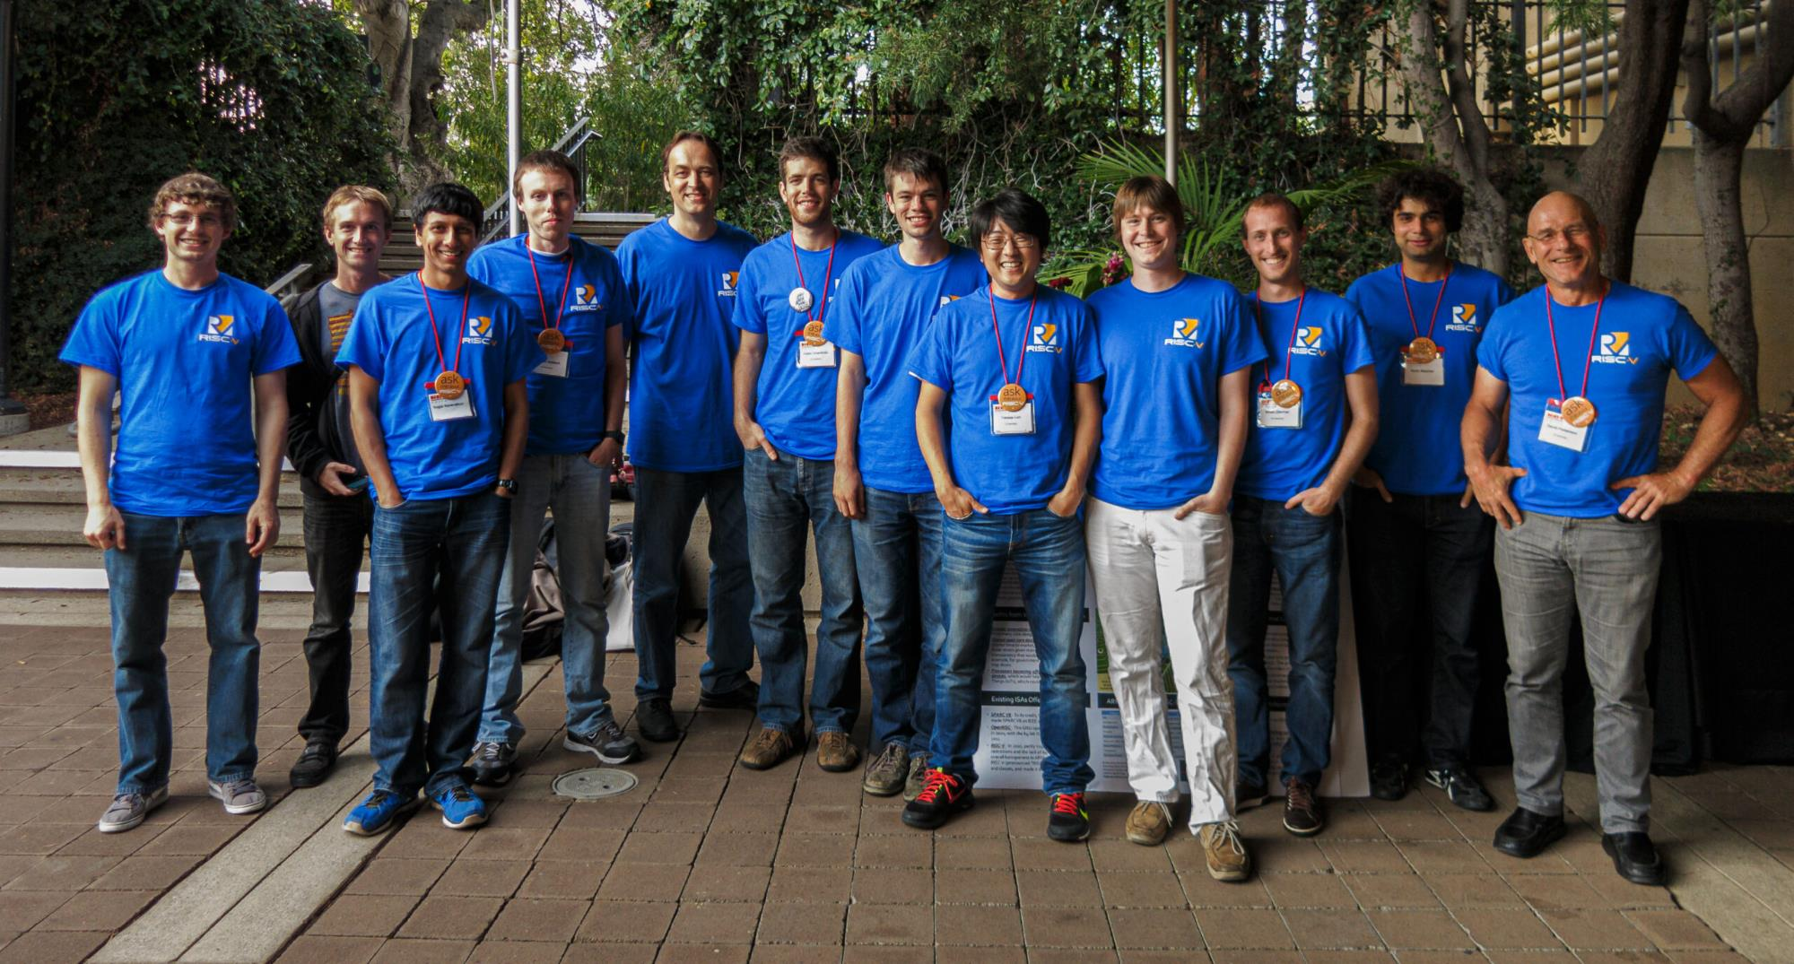
Build RISC-V into your company strategy, and your personal mission
RISC-V is a community of passionate, dedicated, and invested stakeholders
As individuals
As companies
As universities
As public institutions and non-profits
As nations
As one Global, connected movement

Slide 26
“The future of American industry depends on open source tech, … RISC-V is gaining traction in the hardware manufacturing space throughout the world, because it lowers barriers to entry and increases chip development speed.” -- Wired
“Though the architecture was created a decade ago by university professors, RISC-V has been building its ecosystem for years and has started to hit its stride with big licensees like Western Digital, SiFive, and even NVIDIA itself.”
-- VentureBeat
“If it succeeds, RISC-V could lower the cost of developing a new chip and help companies of all sizes to build exactly the processors they need.”
-- Engadget
Notes:
Wired published an article about how “the future of American industry depends on open source tech,” and highlighted how “RISC-V is gaining traction in the hardware manufacturing space throughout the world, because it lowers barriers to entry and increases chip development speed.”
VentureBeat discussed the momentum of RISC-V writing, “Though the architecture was created a decade ago by university professors, RISC-V has been building its ecosystem for years and has started to hit its stride with big licensees like Western Digital, SiFive, and even Nvidia itself.”
Engadget published a 14 minute video discussing RISC-V, and noted that “if it succeeds, RISC-V could lower the cost of developing a new chip and help companies of all sizes to build exactly the processors they need.”

Slide 27
Marketing and Visibility benefits
Share your products and progress with RISC-V!

Slide 28
RISC-V Events
Participating with RISC-V in industry events
Shows your support for open source and RISC-V
Opportunity to demonstrate your knowledge and leadership to the community
Demo your products and collect leads

Slide 29
RISC-V Blog
The RISC-V blog program is a great way to showcase leadership and industry commentary, as well as share technical information on your work with RISC-V.
Members can submit content to publish on riscv.org and we promote on social, as well as a link to the member website to drive traffic.

Slide 30
Case Studies
Case studies help elevate the technical conversations to business objectives and challenges, showing the use and adoption of RISC-V across multiple industries and use cases.
As a member, we will publish your case study!
Case studies will be highlighted on our website and shared via our wide-reaching media channels and analyst relationships.

Slide 31
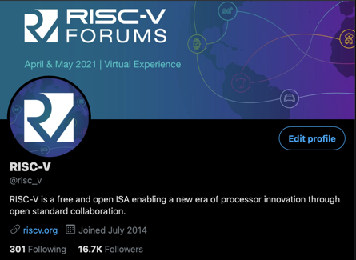
Content - Social
RISC-V is happy to share community, member, and Ambassador content via our social channels!
Members can submit original content for our posting on our social channels
Members and the community can submit content for re-sharing.

Slide 32
Press and Analysts
Share member and community news “In the News”
Highlight member announcements via social
Provide RISC-V team member quotes for member press releases
Options to submit member news and announcements and participate in media panels.

Slide 33
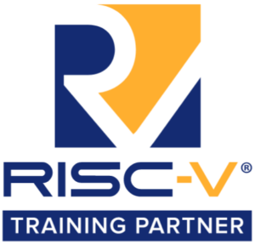
Branding
As a member, use RISC-V branding in your marketing materials!
Branding Guidelines and logos

Slide 34
Working Groups
Join, participate, and engage with the RISC-V Community!

Slide 35
Marketing Committee + Working Groups
Participate in the marketing committee to engage with your peers, learn about member marketing benefits, and contribute.
Marketing Committee
Primary communication tool with members on RISC-V marketing initiatives.
Meetings: 2nd Tuesday of the month, 8am PT (5pm CEST)
Marketing Content Committee Discuss content topics such as website, exchange, and research.
Meetings: Last Tuesday of the month: 8am PT (5pm CEST)
Marketing Events Committee
Discuss upcoming events and actions as well as event plans for future
Meetings: Every other Thursday: 9am PT (6pm CEST)

Slide 36
Technical Working Groups
The technical groups are the heart of RISC-V. These groups create and maintain the hardware ISA and other items around it, including test and debug frameworks, software specs, and other technical artifacts. Visit our Working Groups page to find groups that fit your interests.

Slide 37
Group/Meeting Types & Responsibilities
Group | Responsibilities
Technical Steering Committee (TSC) | Delegation of responsibilities to organizational components below it, strategy, escalations, group & chair & preliminary charter approvals, ratification. voting (most discussion and notification by email, web page listing and supporting docs, automated voting system). The TSC has voting members and non-voting attendees. The voting members include premiers and HC and IC chairs. (non-voting attendees are advisors and RISC-V staff -- no organization can be represented more than once)
Chief Technology Office (CTO) | Runs TSC voting process, both Chairs meetings, Strategy, organization, IT, roadmap, resources, escalations,
ISA Committees (IC) | Approve and oversee package for TSC vote for the creation of ISA Extension TGs and filling the chair and vice-chair vacancies for its TGs. Develop strategy for the groups under it and complete coverage of areas of responsibility under it including gaps.
Horizontal Committees (HC) | Approve and oversee non-extension TGs, and has responsibilities to make sure that all Extension TGs cover the area overseen by the HC before ratification, Responsible for developing a holistic strategy and reaching out to the external ecosystem and community groups.
Horizontal Subcommittees (HSC) | It is a nested HC.
Task Groups (TG) | Must have charter that defines a small set of deliverable work products: extension specifications, standards, requirements, best practices, etc.. TGs under the unpriv and priv SC can have ISA extension work products. TGs under HCs should not have ISA extension work products.
Special Interest Groups (SIG) | Develop strategy for complete coverage of areas of responsibility under it including gaps. Provides continuity on the topic of TGs is may request be created. SIGS produce no work product. Can be created by the TSC, ICs or HCs with TSC approval not required.
Meeting | Responsibilities
Committee Chairs Meeting | TSC strategy discussions. Invitees are IC chairs & HC chairs, RISC-V staff, TSC, and advisors and ad-hoc invitees.
Chairs Meeting | Invitees are RISC-V staff, Chairs & Vice Chairs of all ICs, HCs, HSCs, TGs, & SIGs. Policy approval, general governance, escalations, exceptions, final charter approval, voting as appropriate.

Slide 38
Special Interest Groups (SIGs)
The SIGs have conversations and drive requirements in key industry and technology areas.
SIG Academia and Training
Coordinate outreach to the open source community as well as researchers and educators in academia, and to curate and recommend training materials to both academics and professional training organizations.
Meetings: Every other Thursday: 8am PT (5pm CEST)
SIG High Performance Computing (HPC)
Meetings: Monthly on 3rd Thurs: 4pm PT
SIG Functional Safety
Meetings: Every other Thursday: 8am PT (5pm CEST)
SIG Soft CPU

Slide 39
The Community
Promote your products and people!

Slide 40
RISC-V Alliances
RISC-V regional and industry alliances provide events, maintain relationships, and create multiple feedback channels in a way that no single organization could do on its own. See our alliances page for the full listing.
Regional Alliances
Communicate locally, provide local events, and maintain relationships in a way that no single organization could do on its own.
Industry Alliances
industry alliances create multiple feedback channels on both technical and non-technical topics that help both the RISC-V community and the industries using the RISC-V technology.

Slide 41
RISC-V Training Partners
RISC-V Training Partners are focusing on RISC-V training in a professional setting. The Training Partner Program extends the breadth and reach of RISC-V knowledge, providing opportunities for a broader audience to learn. See our Training Partner page for more information on our training partners or how to become a RISC-V Training Partner.

Slide 42
RISC-V Exchange
The RISC-V Exchange provides a window into work that people have accomplished around the world in the RISC-V community, including physical hardware, IP cores, and a great deal of software.
Available Boards
Available Cores & SoCs
Available Software
To add your products to the Exchange, fill out this Google Form.
Email exchange@riscv.org with any questions.

Slide 43
RISC-V Ambassador Program
RISC-V Ambassadors are individuals passionate about RISC-V and dedicated to growing and engaging the RISC-V community.
Ambassadors are RISC-V experts and work together with RISC-V to ensure our global momentum and adoption. Successful ambassadors include engineers, developers, bloggers, influencers, evangelists who are already engaged with RISC-V in some way, including contributing to work groups, online groups, community events, training, workshops, and more.
The RISC-V Ambassador Program empowers community members with tools and resources to:
Promote RISC-V projects and technology
Educate a local community on the RISC-V mission and technical aspects
Engage RISC-V member participation and community growth
Learn more

Slide 44
Joining RISC-V International

Slide 45
Meet the RISC-V Team
Calista Redmond
CEO
Kim McMahon
Director of Visibility and Community Engagement
Stephano Cetola
Director Technical Programs
Mark Himelstein
CTO
Brett Preston
Program Manager
Jenni McGinnis
Program Manager
Jeff Scheel
Technical Program Manager
Megan Lehn
Program Manager
Thea Aldrich
Marketing Manager

Slide 46
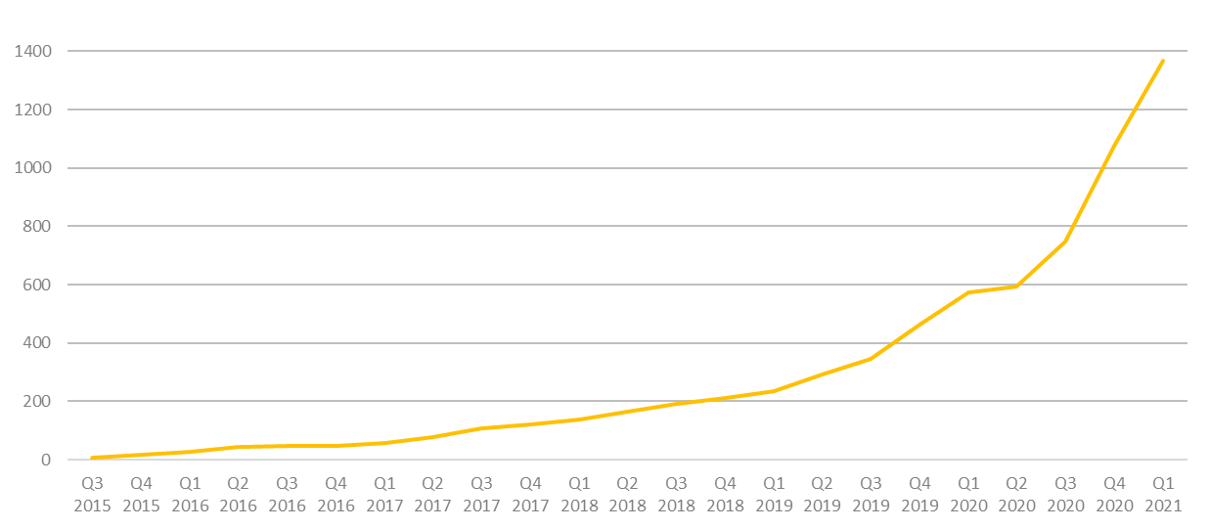
2k+ RISC-V Members
across 70 Countries
94 Chip SoC, IP, FPGA
4 I/O Memory, network, storage
12 Services Fab, design services
40 Software Dev tools, firmware, OS
4 Systems ODM, OEM
13 Industry Cloud, mobile, HPC, ML, automotive
81 Research Universities, Labs, other alliances
1,000+ Individuals
RISC-V engineers and advocates
In 2020, RISC-V membership grew 133%
December 2020

Slide 47
Benefit of joining RISC-V
Accelerate technical traction and insight
Contribute technical priorities, approaches, and code
Gain strategic and technical advantage
Increase visibility, leadership, and market insight
Fill and increase engineering skills, retain and attract talent
Build innovation partner network and customer pipeline
Deepen, engage, and lead in local and industry developer network
Showcase RISC-V products, services, training, and resources

Slide 48
Membership Options
Premier Member Benefits
Board seat and Technical Steering Committee seat included for $250k level
Technical Steering Committee seat included for $100k level
Eligible to lead workgroup and/or committee
Use of RISC-V Trademark for commercialization
Member logo / name listing on RISC-V website, alphabetical with Premier members
Solution / Product listing highlighted on RISC-V Exchange, noted with member level
4 case studies a year
2 blogs per month
2 social media spotlights per month
Spotlight member profile
Event sponsorship discount
Strategic Member Benefits
3 Board reps elected for the Strategic tier, including Premier members that do not otherwise have a board seat
Eligible to lead workgroup and/or committee
Use of RISC-V Trademark for commercialization
Member logo / name listing on RISC-V website, alphabetical with Strategic members
Solution / Product listing highlighted on the RISC-V Exchange, noted with member level
1 case study a year
1 blog per month
1 social media spotlight per month
Event sponsorship discount
Community Member Benefits
Two Board representatives
1 Community Board representative, elected
1 Individual Board representative, elected
Member logo / name listing on RISC-V website, by member level
1 case study a year
1 blog per quarter
1 social media spotlight per quarter
Event sponsorship discount
Premier Requirements
Membership open to any type of legal entity
$250k Annual membership fee that includes Board seat and TSC seat
$100k Annual membership fee that includes TSC seat
Strategic Member Requirements
Membership open to any type of legal entity
Annual membership fee based on employee size
5,000+ employees: $35k
500-5,000 employees: $15k
<500 employees: $5k
<10 employees & company <2 yrs old: $2k
Community Requirements
Membership open to
academic institutions,
non-profits,
individuals not representing a legal entity
No annual membership fee

Slide 49
Technical Deliverables
Guard against fragmentation
Build technical deliverables
Collaborate with technical working groups & SIGs,
Architecture Compatibility
Testing and compatibility suites
Architecture tests
Visibility
Amplify member news, content, and success with press and analysts
Original content programs
RISC-V, industry, and regional events
Learn
Multi-level online learning
Connecting universities with labs, tests, and curricula
RISC-V Training Partners
Advocacy + Alliances
RISC-V Ambassadors
Geo and industry alliances
Local developer groups and events
Marketplace Exchange
Online marketplace of providers, products, services, and learn
Technical developer forums
RISC-V delivers incredible member support

Slide 50
Thank you
Questions: info@riscv.org

