Slide 1
Member Benefits and Welcome!
Kim McMahon
Director of Visibility and Community Engagement
RISC-V International

Slide 2
Welcome!
Introductions
Tell us about your organization!
Company background
Your goals in joining RISC-V
Describe your work with RISC-V technologies

Slide 3
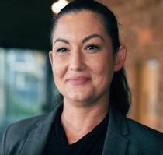
Meet the RISC-V Team
Calista Redmond
CEO
Kim McMahon
Director of Visibility and Community Engagement
Stephano Cetola
Director Technical Programs
Mark Himelstein
CTO
Brett Preston
Program Manager
Jenni McGinnis
Program Manager
Jeff Scheel
Technical Program Manager
Megan Lehn
Program Manager
Thea Aldrich
Marketing Manager

Slide 4
RISC-V
Measures of Progress

Slide 5
Welcome to the Open era of computing.
RISC-V is the free and open Instruction Set Architecture…
Driven through open collaboration
Enabling freedom of design across all domains and industries
Cementing the strategic foundation of semiconductors

Slide 6
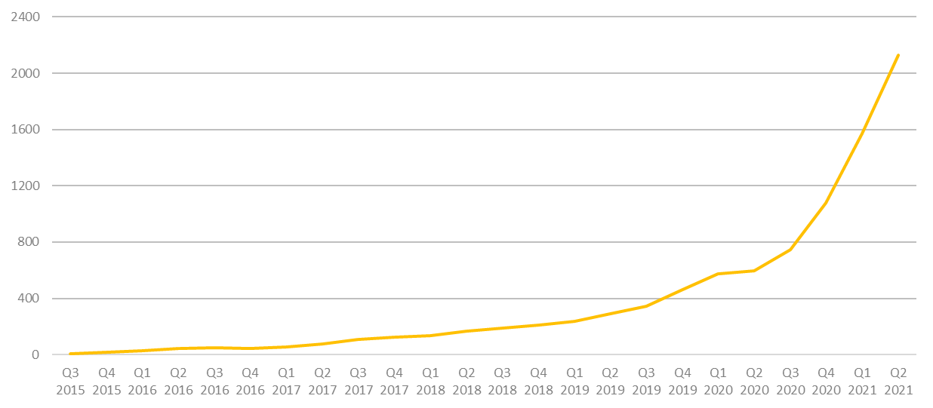
More than 2,200 RISC-V Members
across 70 Countries
102 Chip
SoC, IP, FPGA
4 I/O
Memory, network, storage
17 Services
Fab, design services
42 Software
Dev tools, firmware, OS
4 Systems ODM, OEM
13 Industry Cloud, mobile, HPC, ML, automotive
95 Research Universities, Labs, other alliances
1,900+ Individuals
RISC-V engineers and advocates
RISC-V membership grew 133% in 2020.
In 2021, RISC-V membership has already doubled.
6
June 2021

Slide 7
Industry innovation on RISC-V
Hardware
– RV64, multi-heart CPUs, vectors, bit manipulation, hypervisors, debug mode –
AI SoCs
Application processors
Software
Linux
Drivers
AI Compilers
Hardware
– RV32, privilege modes, interrupts –
IoT SoCs
Microcontrollers
Software
RTOS
Firmware
Hardware
– RV32 –
Proof of Concept SoCs
Minion processors for power management, communications, …
Software
Bare metal software
Hardware
ISA Definition
Test Chips
Software
Tests
Complexity
2010 – 2016
2017 – 2018
2019 – 2020
2021

Slide 8
Incredible industry progress
The European Processor Initiative finalized the first version of its RISC-V accelerator architecture and will deliver test chip in 2021.
The RIOS Lab announced PicoRio, an affordable RISC-V open source small-board computer available in 2021.
Imperas announced first RISC-V verification reference model with UVM encapsulation.
Seagate announced hard disk drive controller with high-performance RISC-V CPU.
GreenWaves ultra-low power GAP9 hearables platform enabling scene-aware and neural network-based noise reduction.
Alibaba unveiled RV64GCV core in its Xuantie 910 processor for cloud and edge servers.
Microchip released the first SoC FPGA development kit based on the RISC-V ISA.
Andes released superscalar multicore and L2 cache controller processors.
StarFive released the world’s first RISC-V AI visual processing platform
SiFive unveiled world’s fastest development board for RISC-V Personal Computers.
Micro Magic announced an incredibly fast 64-bit RISC-V core achieving 5GHz and 13,000 CoreMarks at 1.1V.
Notes:
The European Processor Initiative partners have finalized the first version of its RISC-V accelerator architecture, named EPAC, and are working towards the delivery of the first EPAC Test Chip in 2021. Link
The RISC-V International Open Source Laboratory (also known as RIOS Lab), announced the PicoRio open-source project. The PicoRio will be a RISC-V-based small-board computer available at an affordable price point, and will be available to ship in the first half of 2021. Link
Imperas announced the first reference model with UVM encapsulation for RISC-V verification.
Micro Magic announced the world’s fastest 64-bit RISC-V core achieving 5GHz and 13,000 CoreMarks at 1.1V.
Microchip released the industry’s first SoC FPGA development kit based on the RISC-V ISA.
Saifang Technology released the world’s first RISC-V AI visual processing platform-Jinghong 7100.
SiFive unveiled the world’s fastest RISC-V development board. The board is available for $665.

Slide 9
Membership
What it means and what you get!

Slide 10
Benefit of joining RISC-V
Accelerate technical traction and insight
Contribute technical priorities, approaches, and code
Gain strategic and technical advantage
Increase visibility, leadership, and market insight
Fill and increase engineering skills, retain and attract talent
Build innovation partner network and customer pipeline
Deepen, engage, and lead in local and industry developer network
Showcase RISC-V products, services, training, and resources

Slide 11
Membership Options
Premier Member Benefits
Board seat and Technical Steering Committee seat included for $250k level
Technical Steering Committee seat included for $100k level
Eligible to lead workgroup and/or committee
Use of RISC-V Trademark for commercialization
Member logo / name listing on RISC-V website, alphabetical with Premier members
Solution / Product listing highlighted on RISC-V Exchange, noted with member level
4 case studies a year
2 blogs per month
2 social media spotlights per month
Spotlight member profile
Event sponsorship discount
Strategic Member Benefits
3 Board reps elected for the Strategic tier, including Premier members that do not otherwise have a board seat
Eligible to lead workgroup and/or committee
Use of RISC-V Trademark for commercialization
Member logo / name listing on RISC-V website, alphabetical with Strategic members
Solution / Product listing highlighted on the RISC-V Exchange, noted with member level
1 case study a year
1 blog per month
1 social media spotlight per month
Event sponsorship discount
Community Member Benefits
Two Board representatives
1 Community Board representative, elected
1 Individual Board representative, elected
Member logo / name listing on RISC-V website, by member level
1 case study a year
1 blog per quarter
1 social media spotlight per quarter
Event sponsorship discount
Premier Requirements
Membership open to any type of legal entity
$250k Annual membership fee that includes Board seat and TSC seat
$100k Annual membership fee that includes TSC seat
Strategic Member Requirements
Membership open to any type of legal entity
Annual membership fee based on employee size
5,000+ employees: $35k
500-5,000 employees: $15k
<500 employees: $5k
<10 employees & company <2 yrs old: $2k
Community Requirements
Membership open to
academic institutions,
non-profits,
individuals not representing a legal entity
No annual membership fee

Slide 12
Technical engagement

Slide 13
Technical Working Groups
The technical groups are the heart of RISC-V. These groups create and maintain the hardware ISA and other items around it, including test and debug frameworks, software specs, and other technical artifacts. Visit our Working Groups page to find groups that fit your interests.

Slide 14
Group/Meeting Types & Responsibilities
Group | Responsibilities
Technical Steering Committee (TSC) | Delegation of responsibilities to organizational components below it, strategy, escalations, group & chair & preliminary charter approvals, ratification. voting (most discussion and notification by email, web page listing and supporting docs, automated voting system). The TSC has voting members and non-voting attendees. The voting members include premiers and HC and IC chairs. (non-voting attendees are advisors and RISC-V staff -- no organization can be represented more than once)
Chief Technology Office (CTO) | Runs TSC voting process, both Chairs meetings, Strategy, organization, IT, roadmap, resources, escalations,
ISA Committees (IC) | Approve and oversee package for TSC vote for the creation of ISA Extension TGs and filling the chair and vice-chair vacancies for its TGs. Develop strategy for the groups under it and complete coverage of areas of responsibility under it including gaps.
Horizontal Committees (HC) | Approve and oversee non-extension TGs, and has responsibilities to make sure that all Extension TGs cover the area overseen by the HC before ratification, Responsible for developing a holistic strategy and reaching out to the external ecosystem and community groups.
Horizontal Subcommittees (HSC) | It is a nested HC.
Task Groups (TG) | Must have charter that defines a small set of deliverable work products: extension specifications, standards, requirements, best practices, etc.. TGs under the unpriv and priv SC can have ISA extension work products. TGs under HCs should not have ISA extension work products.
Special Interest Groups (SIG) | Develop strategy for complete coverage of areas of responsibility under it including gaps. Provides continuity on the topic of TGs is may request be created. SIGS produce no work product. Can be created by the TSC, ICs or HCs with TSC approval not required.
Meeting | Responsibilities
Committee Chairs Meeting | TSC strategy discussions. Invitees are IC chairs & HC chairs, RISC-V staff, TSC, and advisors and ad-hoc invitees.
Chairs Meeting | Invitees are RISC-V staff, Chairs & Vice Chairs of all ICs, HCs, HSCs, TGs, & SIGs. Policy approval, general governance, escalations, exceptions, final charter approval, voting as appropriate.

Slide 15
Horizontal
Technical Organization
Board of Directors (BoD)
Technical Steering Committee (TSC)
CTO, Staff
Architecture Profiles
Industry Verticals SIG
Unpriv IC
Priv IC
Software HC
(Platforms, Toolchains, Runtimes)
IMAFDQC
1.11
Memory Model
Security HC
B TG
1.12 (Priv)
RASD HC
V TG
VM TG
Technology HC
J TG
FastInt TG
SoC Infra. HC
(Trace & Debug)
P TG
CMO TG
Consumer
Defense/MilAero
Automotive
Data Center
Finance
Communications
Oil & Gas
TEE TG
Implementation HC
Zfinx TG
H TG
ISA Infrastructure HC
Code Size TG
Krypto TG
Alt FP TG
inception
dotted line
pending

Slide 16
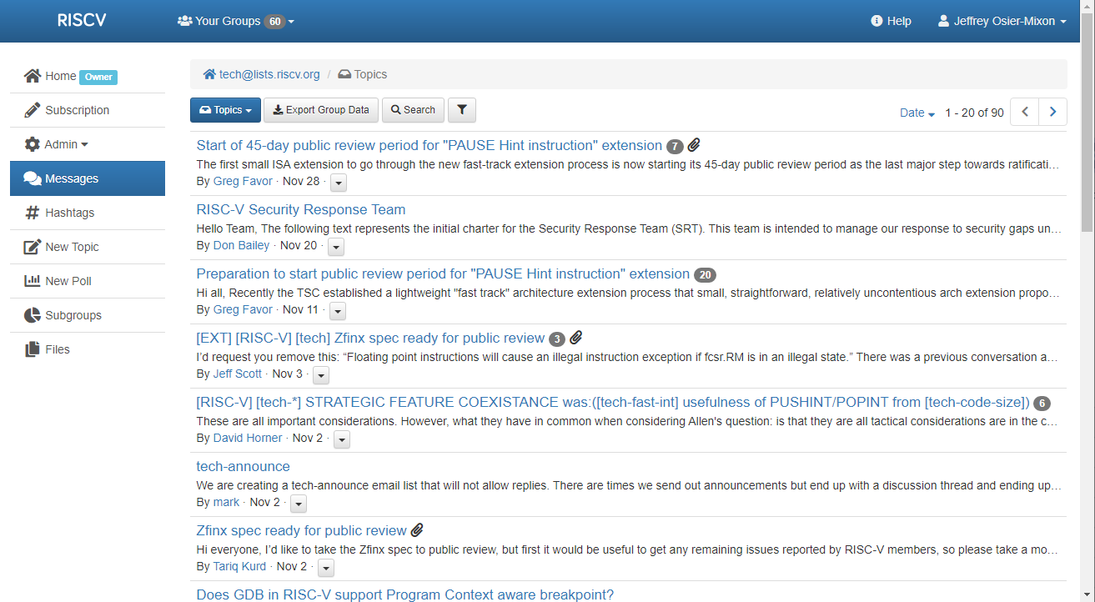
Member Portal - lists.riscv.org

Slide 17
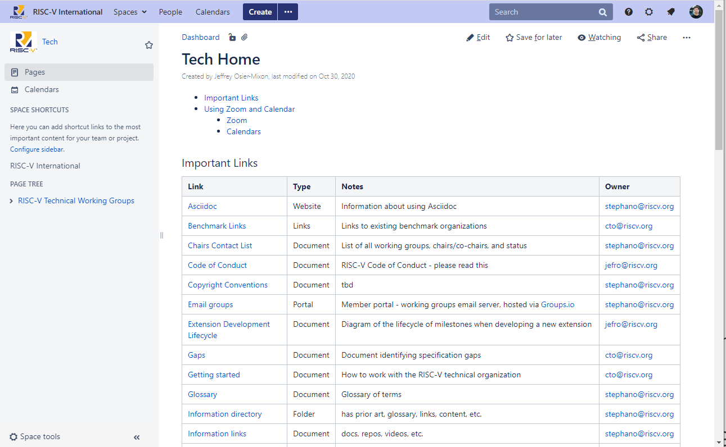
Tech Wiki - wiki.riscv.org

Slide 18
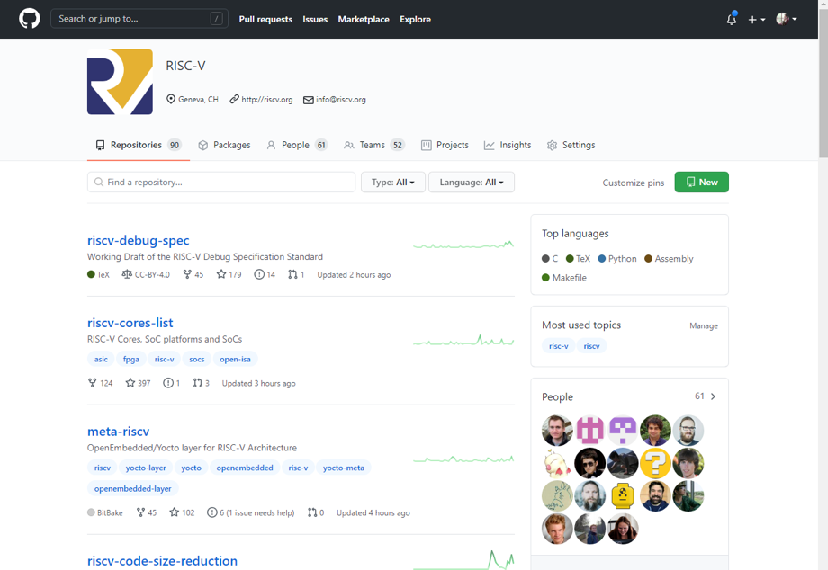
GitHub - github.com/riscv

Slide 19
Regular meetings
All Hands meetings
Quarterly summary, open to all members.
Technical Working Group meetings
Committees & task groups meet via Zoom, usually on 1-2 week cadence. All members are welcome to participate.
Technical Steering Committee (TSC) & Committee Chairs Meeting (CCM)
TSC = technical organization governance. TSC members only.
CCM = TSC strategy discussions. Invitees are: TSC members + IC chairs & HC chairs, RISC-V staff, advisors and ad-hoc invitees
Tech Chairs Meetings (TCM)
Policy approval, general governance, escalations, exceptions, final charter approval, voting as appropriate. Chairs & Vice Chairs of all ICs, HCs, HSCs, TGs, & SIGs, RISC-V staff.

Slide 20
Visibility and Engagement

Slide 21
Marketing Committee + Working Groups
Participate in the marketing committee to engage with your peers, learn about member marketing benefits, and contribute.
Marketing Committee
Primary communication tool with members on RISC-V marketing initiatives.
Meetings: 2nd Tuesday of the month, 8am PT (5pm CEST)
Marketing Content Committee Discuss content topics such as website, exchange, and research.
Meetings: Last Tuesday of the month: 8am PT (5pm CEST)
Marketing Events Committee
Discuss upcoming events and actions as well as event plans for future
Meetings: Every other Thursday: 9am PT (6pm CEST)

Slide 22
Events

Slide 23
RISC-V Hosted & Supported Events
RISC-V Summit
RISC-V Forums
RISC-V Days
Our flagship events held in 3 geographies:
Europe: Spring
China: Summer
North America: Winter
Formats:
RISC-V organized
Keynotes, multiple tracks, networking
Sponsorships to cover costs
Smaller virtual or regional events focused heavily on RISC-V technologies and learning.
Formats:
RISC-V organized
Short-form, single-topic webinars
Workshops
Roadshows
Hands-on learning events
Sponsorships to cover costs
Regional events organized by the community.
RISC-V supported and promoted.
Formats:
RISC-V Day <city>
Keynotes, multiple tracks, networking
Organized, managed, and paid for by the community
RISC-V supported

Slide 24
Upcoming Forums
Short-form, single-topic events
Schedule Wednesday August 11!
Register!
Currently Registered - 246
September 15
7:00 - 10:00am PDT
Please promote registration!

Slide 25
RISC-V Summit 2021
Date(s): December 6 - 8, 2021
Location: Moscone West, San Francisco, CA (Co-Located with DAC)
Format: Hybrid (In-Person and Virtual)
Keynotes
2 Breakout Session Rooms
Large RISC-V Summit area on the DAC expo floor with Demo Theater
Call for Proposals: Closes Sept 10
Sponsorships: Closes Oct 22
Register:
Virtual and in-person pricing available
Standard pricing (lowest pricing): Available until Oct 31
Diversity & Needs based Scholarships: Due Oct 29
If anyone is interested in reviewing the applications, let Kim know.
Questions? Contact events@risv.org

Slide 26
Marketing and Visibility benefits
Share your products and progress with RISC-V!

Slide 27
RISC-V Events
Participating with RISC-V in industry events
Shows your support for open source and RISC-V
Opportunity to demonstrate your knowledge and leadership to the community
Demo your products and collect leads

Slide 28
RISC-V Blog
The RISC-V blog program is a great way to showcase leadership and industry commentary, as well as share technical information on your work with RISC-V.
Members can submit content to publish on riscv.org and we promote on social, as well as a link to the member website to drive traffic.

Slide 29
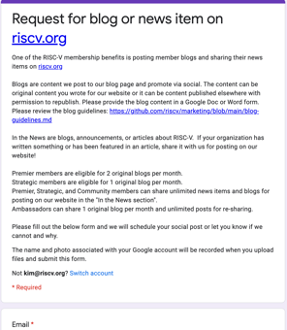
Submitting request for Blog and In the News
Members get original blog posts?
Premier: 2 blog posts per month
Strategic: 1 blog post per month
Premier, Strategic, Community: “unlimited” In the News (within reason and at our discretion)
Please read the Blog Guidelines
How?
Fill out the Google Form
You can share a Blog AND In the News post in one form
If you have an image, there is an option to add it. Make sure to name your image so we know it’s yours!
Put in the suggested date for the post and we’ll post as close to your requested date as possible.
If we can’t post your content, we’ll reply and let you know why.

Slide 30
Case Studies
Case studies help elevate the technical conversations to business objectives and challenges, showing the use and adoption of RISC-V across multiple industries and use cases.
As a member, we will publish your case study!
Case studies will be highlighted on our website and shared via our wide-reaching media channels and analyst relationships.

Slide 31
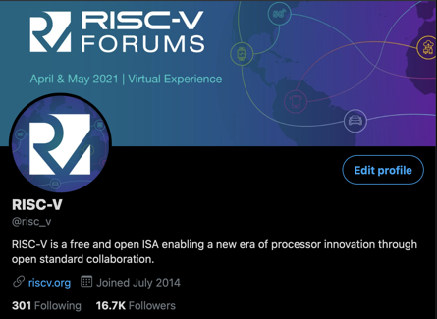
Content - Social
RISC-V is happy to share community, member, and Ambassador content via our social channels!
Members can submit original content for our posting on our social channels
Members and the community can submit content for re-sharing.

Slide 32
Submitting a request for a social post
Members get original social posts?
Premier: 2 social posts per month
Strategic: 1 social post per month
Premier, Strategic, Community: “unlimited” re-shares (within reason and at our discretion)
Please review the Social Guidelines
How?
Fill out the Google Form
You can share a Twitter AND LinkedIn post in one form
If you have an image, there is an option to add it. Make sure to name your image so we know it’s yours!
Put in the suggested date for the post and we’ll post as close to your requested date as possible.
If we can’t post your content, we’ll reply and let you know why.

Slide 33
Press and Analysts
Share member and community news “In the News”
Highlight member announcements via social
Provide RISC-V team member quotes for member press releases
Options to submit member news and announcements and participate in media panels.

Slide 34
Branding
As a member, use RISC-V branding in your marketing materials!
Branding Guidelines and logos

Slide 35
Navigating the community

Slide 36
Marketing Committee + Working Groups
Participate in the marketing committee to engage with your peers, learn about member marketing benefits, and contribute.
Marketing Committee
Primary communication tool with members on RISC-V marketing initiatives.
Meetings: 2nd Tuesday of the month, 8am PT (5pm CEST)
Marketing Content Committee Discuss content topics such as website, exchange, and research.
Meetings: Last Tuesday of the month: 8am PT (5pm CEST)
Marketing Events Committee
Discuss upcoming events and actions as well as event plans for future
Meetings: Every other Thursday: 9am PT (6pm CEST)

Slide 37
Special Interest Groups (SIGs)
The SIGs have conversations and drive requirements in key industry and technology areas.
SIG Academia and Training
Coordinate outreach to the open source community as well as researchers and educators in academia, and to curate and recommend training materials to both academics and professional training organizations.
Meetings: Every other Thursday: 8am PT (5pm CEST)
SIG High Performance Computing (HPC)
Meetings: Monthly on 3rd Thurs: 4pm PT
SIG Functional Safety
Meetings: Every other Thursday: 8am PT (5pm CEST)
SIG Soft CPU

Slide 38
RISC-V Alliances
RISC-V regional and industry alliances provide events, maintain relationships, and create multiple feedback channels in a way that no single organization could do on its own. See our alliances page for the full listing.
Regional Alliances
Communicate locally, provide local events, and maintain relationships in a way that no single organization could do on its own.
Industry Alliances
industry alliances create multiple feedback channels on both technical and non-technical topics that help both the RISC-V community and the industries using the RISC-V technology.

Slide 39
RISC-V Learn
Learning RISC-V is a challenging, highly rewarding activity. There are many resources available to help you on this technical journey, and we welcome new additions to these resources – please contact us at info@riscv.org with any questions or comments.
RISC-V Learn Online
Online learning at beginner, intermediate, and advanced levels to increase engineering expertise and career opportunity on RISC-V across the industry.
RISC-V Training Partners Provide RISC-V training in a professional setting to extend the breadth and reach of RISC-V knowledge
University Resources
Universities that support RISC-V curriculum and other programing as well as books and other learning resources.

Slide 40
RISC-V Training Partners
RISC-V Training Partners are focusing on RISC-V training in a professional setting. The Training Partner Program extends the breadth and reach of RISC-V knowledge, providing opportunities for a broader audience to learn. See our Training Partner page for more information on our training partners or how to become a RISC-V Training Partner.

Slide 41
RISC-V Exchange
The RISC-V Exchange provides a window into work that people have accomplished around the world in the RISC-V community, including physical hardware, IP cores, and a great deal of software.
Available Boards
Available Cores & SoCs
Available Software
To add your products to the Exchange, fill out this Google Form.
Email exchange@riscv.org with any questions.

Slide 42
RISC-V Ambassador Program
RISC-V Ambassadors are individuals passionate about RISC-V and dedicated to growing and engaging the RISC-V community.
Ambassadors are RISC-V experts and work together with RISC-V to ensure our global momentum and adoption. Successful ambassadors include engineers, developers, bloggers, influencers, evangelists who are already engaged with RISC-V in some way, including contributing to work groups, online groups, community events, training, workshops, and more.
The RISC-V Ambassador Program empowers community members with tools and resources to:
Promote RISC-V projects and technology
Educate a local community on the RISC-V mission and technical aspects
Engage RISC-V member participation and community growth
Requirements to be an official RISC-V Ambassador:
Organizational Member of RISC-V International
Already engaged with RISC-V as a contributor, blogger, speaker, etc.
Willing to speak on RISC-V topics at events
Contribute technical content such as blog post, video tutorial, training module, etc.
Host or speak at local RISC-V events
Learn more

Slide 43
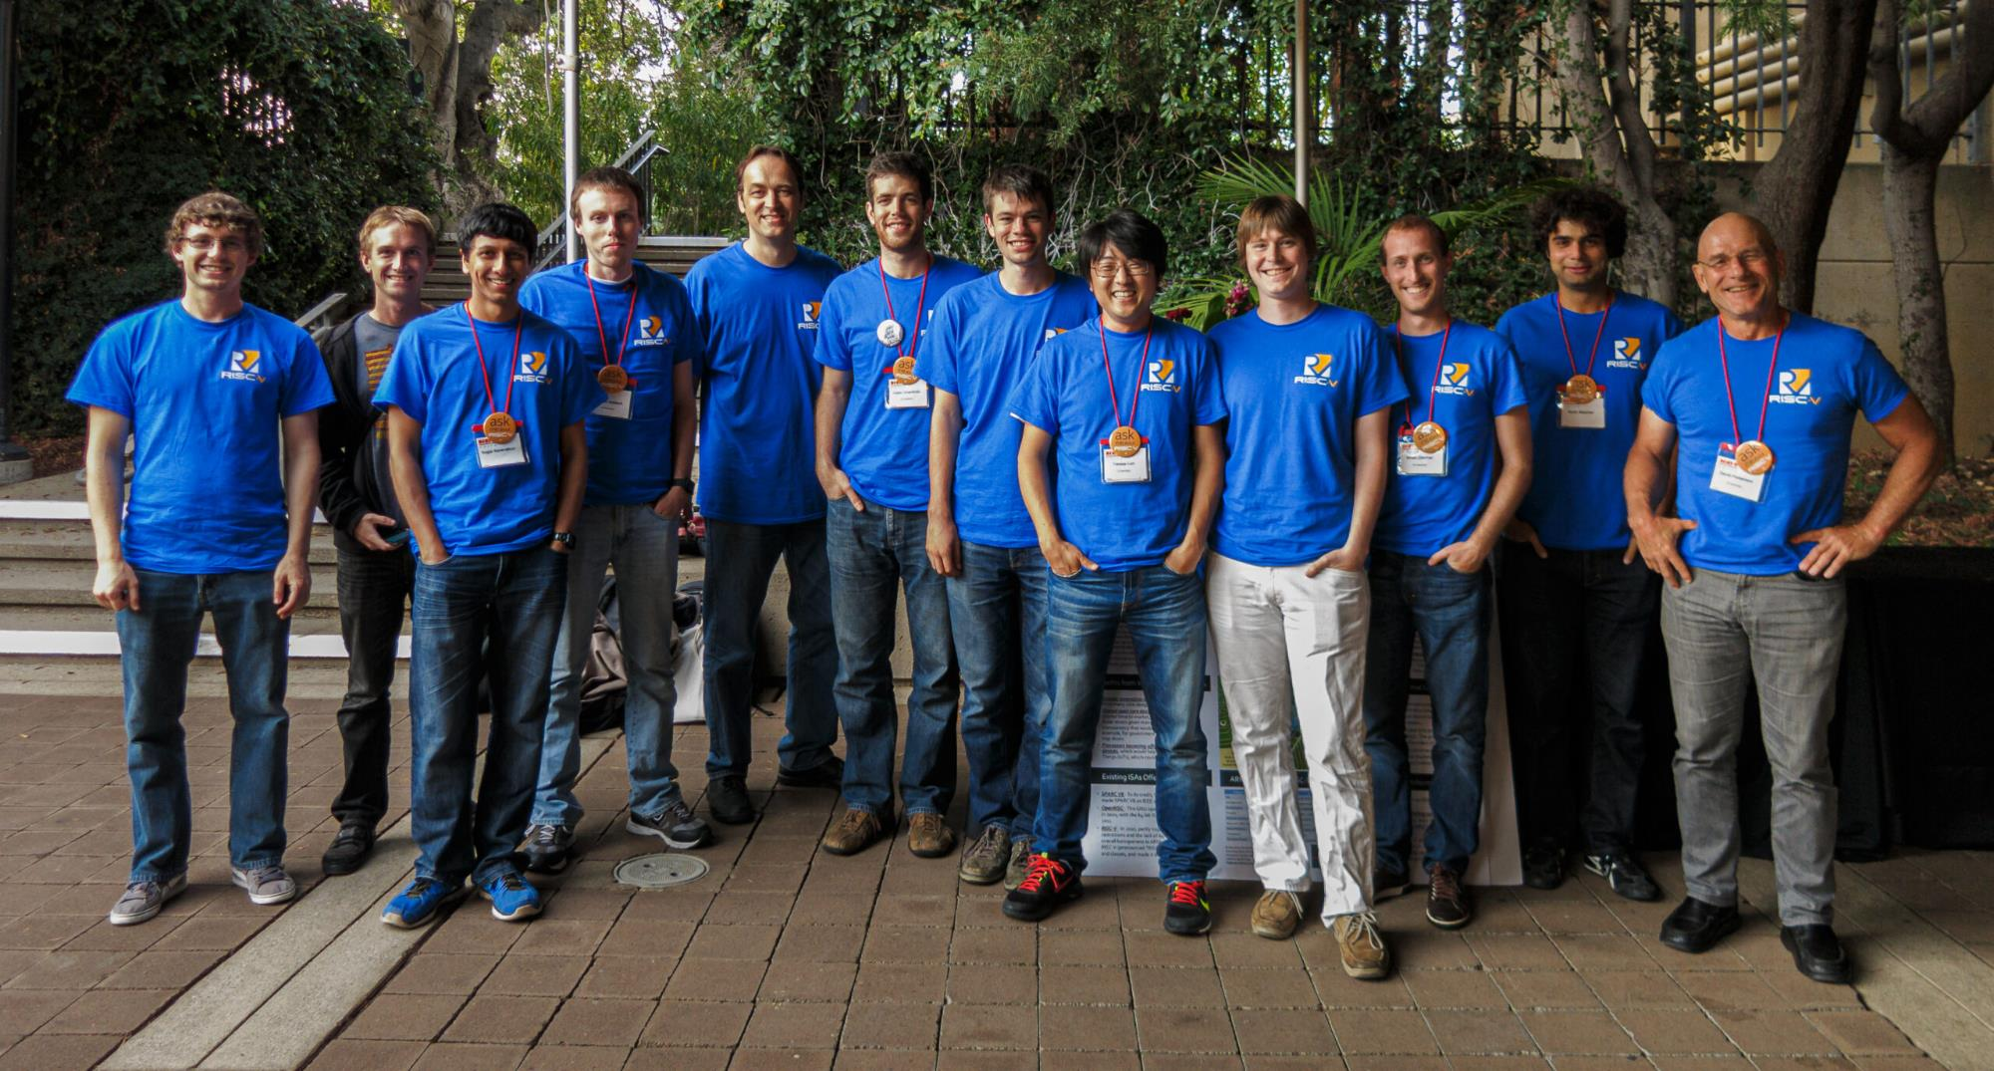
Build RISC-V into your company strategy, and your personal mission
RISC-V is a community of passionate, dedicated, and invested stakeholders
As individuals
As companies
As universities
As public institutions and non-profits
As nations
As one Global, connected movement

Slide 44
Thank you
Questions: info@riscv.org

Slide 45
RISC-V Color Palette
#ffc72c
255 199 44
California Gold
A primary color used throughout our branding.
#011e41
1 3 65
Secondary color dark blue.
Use for color variability in graphics.
#0a6b7c
10 107 124
Secondary color dark teal
Heavily used throughout our branding,with Berkeley Blue
#cb007b
203 0 123
Secondary color pink
Used for emphasis, trend lines.
#60269e
96 38 158
Secondary color dark purple.
Use for color variability in graphics.
#fdda64
253 218 100
Secondary color gold
Used for accents
#0a3799
10 55 153
Berkeley Blue
Our primary blue used throughout our branding.
#62cbc9
98 203 201
Secondary color light teal.
Use for color variability in graphics.
#fe9bb1
254 155 177
Secondary color light pink.
Use for color variability in graphics.
#c2a6e1
194 166 255
Secondary color light purple.
Use for color variability in graphics.

Slide 46
Gradient Elements
Gradient Background
Overlay Gradient

